Slide 3
Basic Life Support (BLS)
In the name of God

Slide 6
شانس زنده ماندن به ازاء هر دقیقه عدم درمان به شدت کاهش می یابد
4-0 دقیقه
اگر احیاء شروع شود احتمال آسیب مغزی کم است
6-4 دقیقه
آسیب مغزی ممکن است
10-6 دقیقه
آسیب مغزی احتمال دارد
0
4
6
10
بیش از 10دقیقه
آسیب شدید مغزی یا مرگ مغزی

Slide 7
BASIC LIFE SUPPORT (BLS)

Slide 8
Survival to hospital discharge presently approximately 5-10%
Bystander CPR ,vital intervention before arrival of emergency services
Early resuscitation and prompt defibrillation (within 1-2 minutes) can result in >60% survival

Slide 14
BASIC LIFE SUPPORT
Approach safely
Check response
Check breathing
Shout for help & Call 115
30 chest compressions
2 rescue breaths

Slide 15
APPROACH SAFELY!
Scene
Rescuer
Victim
Bystanders
Approach safely
Check response
Check breathing
Shout for help & Call 115
30 chest compressions
2 rescue breaths

Slide 16
CHECK RESPONSE CHECK BREATHING
Approach safely
Check response
Check breathing
Shout for help & Call 115
30 chest compressions
2 rescue breaths

Slide 17
CHECK RESPONSE
Shake shoulders gently
Ask “Are you all right?”
If he responds
Leave as you find him.
Find out what is wrong.
Reassess regularly.

Slide 18
AGONAL BREATHING and GASPING
Occurs shortly after the heart stops
in up to 40% of cardiac arrests
Described as barely, heavy, noisy or gasping breathing
Recognise as a sign of cardiac arrest
Notes:
18

Slide 19
SHOUT FOR HELP
Approach safely
Check response
Check breathing
Shout for help & Call 115
30 chest compressions
2 rescue breaths

Slide 20
LOOK , LISTEN ,FEEL

Slide 21
Call 115
Approach safely
Check response
Check breathing
Shout for help & Call 115
30 chest compressions
2 rescue breaths

Slide 22
Call 115
What happened
location
number and condition of victims
type of aid provided

Slide 23
Check pulse
Feel within 10 sec.
1. definite pulse 🡺 give 1 breath / q 5-6 s
2. recheck pulse q 2 min.
3. no pulse 🡺 next step

Slide 24
Chest compressions are the foundation of CPR
All rescuers, regardless of training, should provide chest compressions to all cardiac arrest victims.

Slide 25
30 CHEST COMPRESSIONS
Approach safely
Check response
Check breathing
Shout for help & Call 115
30 chest compressions
2 rescue breaths

Slide 26
CHEST COMPRESSIONS
supine victim on a hard surface
Place the heel of one hand in the centre of the chest ( lower half )
Place other hand on top
Interlock fingers

Slide 27
CONTINUE CPR
30
2
Notes:
27

Slide 28
ABCD
A → Air way
B → Breathing
C → Circulation
D → Defibrillation

Slide 29
راه هوایی
A ← ارزیابی و بازنگهداشتن راه هوایی
Head tilt – chin lift maneuver
Jaw thrust maneuver

Slide 30
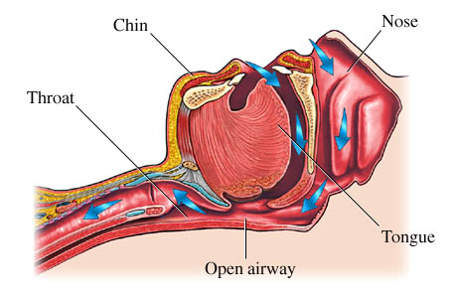

Slide 31
Head Tilt- Chin Lift

Slide 32
Jaw Thrust

Slide 33
Head tilt – chin lift

Slide 34
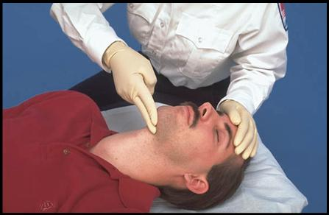

Slide 35
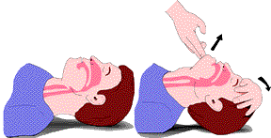

Slide 36
Head tilt – jaw thrust

Slide 37
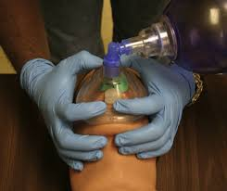
E-C clamp technique

Slide 38
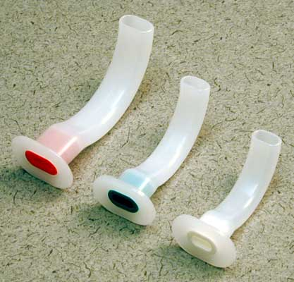
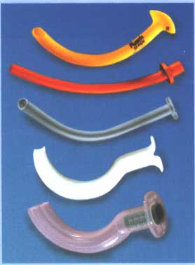
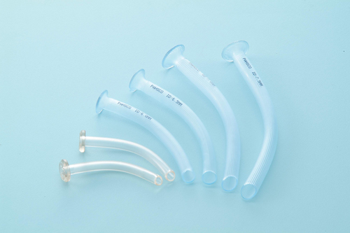

Slide 39
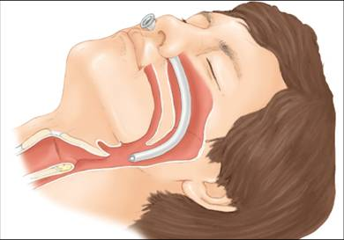

Slide 40
تنفس
B ← ارزیابی و کمک تنفسی

Slide 41
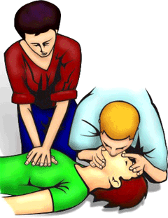

Slide 43
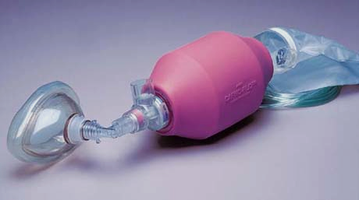

Slide 44
جریان خون
C ← 10 ثانیه ارزیابی نبض مرکزی

Slide 45
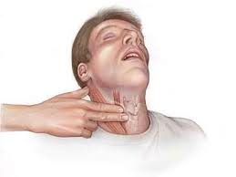
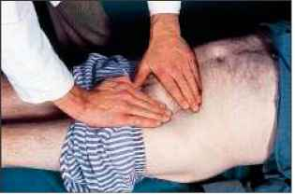
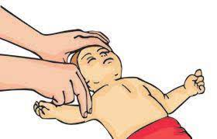

Slide 46
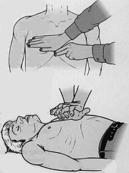

Slide 47
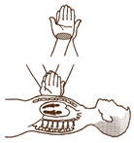

Slide 48
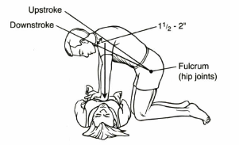

Slide 49
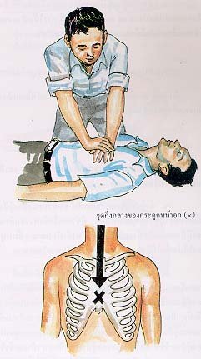

Slide 50
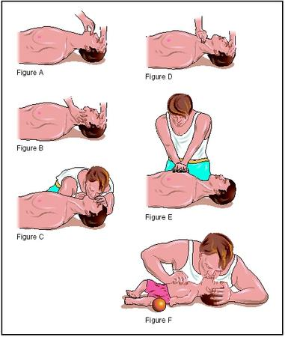

Slide 51
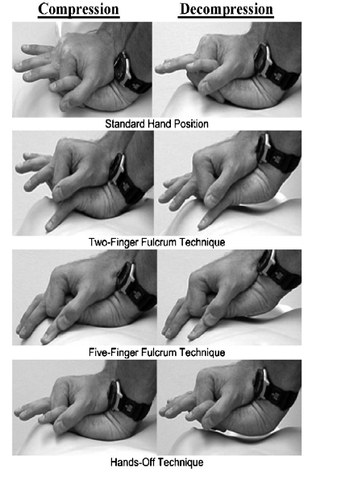
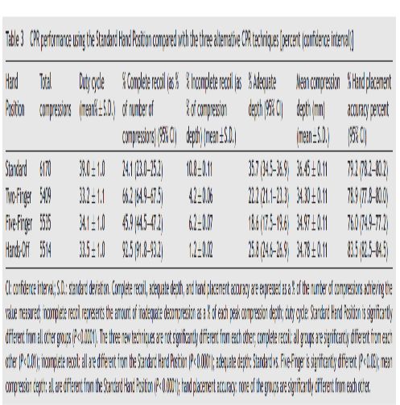

Slide 52
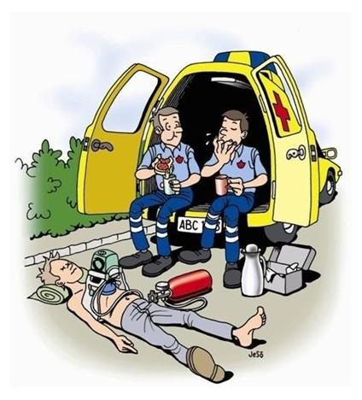
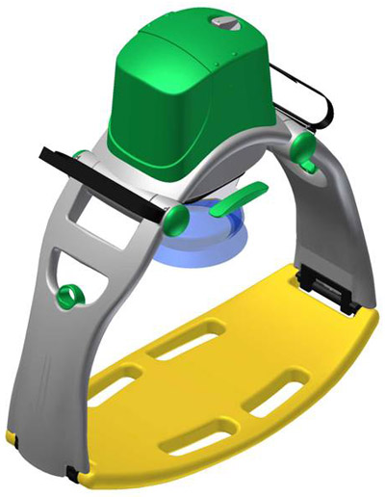
Mechanical CPR?

Slide 53
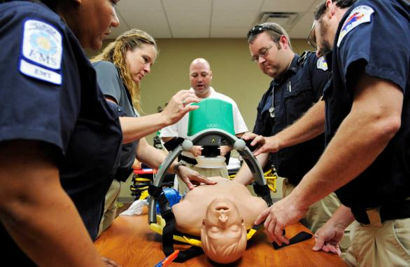

Slide 54
دفیبریلاسیون
D ← دفیبریلاسیون الکتریکی (AED, DC shock)

Slide 56
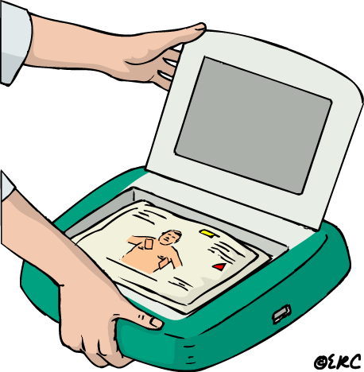
SWITCH ON AED
Some AEDs will automatically switch them-selves on when the lid is opened
Notes:
56

Slide 57
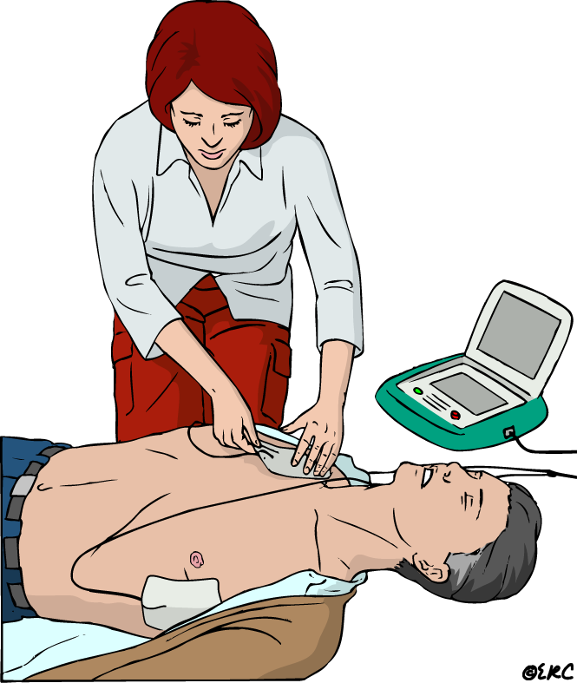
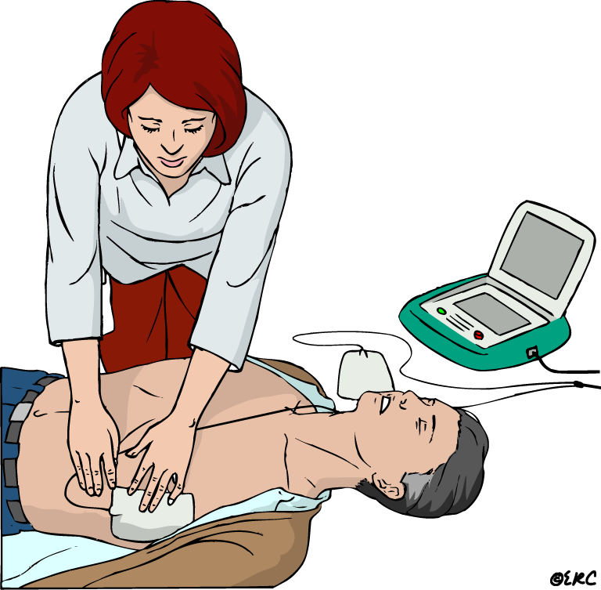
ATTACH PADS TO CASUALTY’S BARE CHEST
Notes:
57

Slide 58
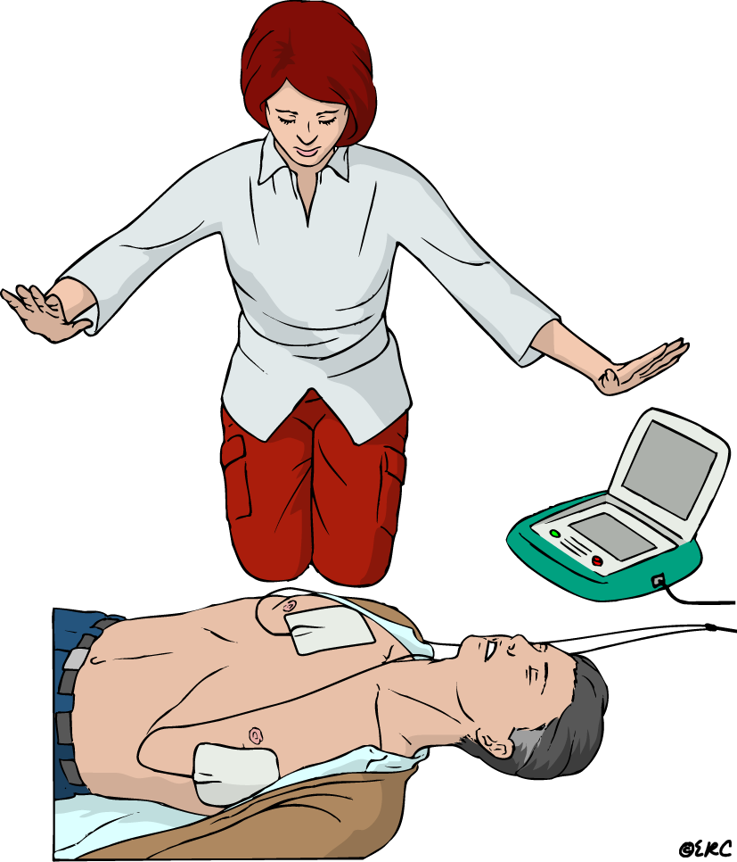
ANALYSING RHYTHM DO NOT TOUCH VICTIM
Notes:
58

Slide 59
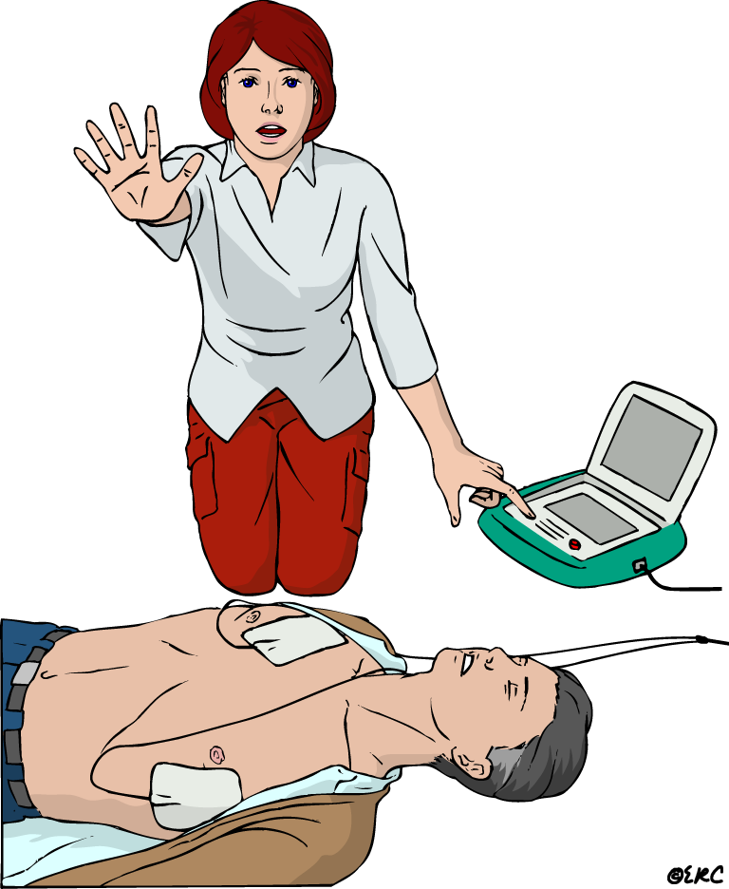
SHOCK INDICATED
Stand clear
Deliver shock
Notes:
59

Slide 60
ANALYSING RHYTHM DO NOT TOUCH VICTIM
Notes:
60

Slide 61
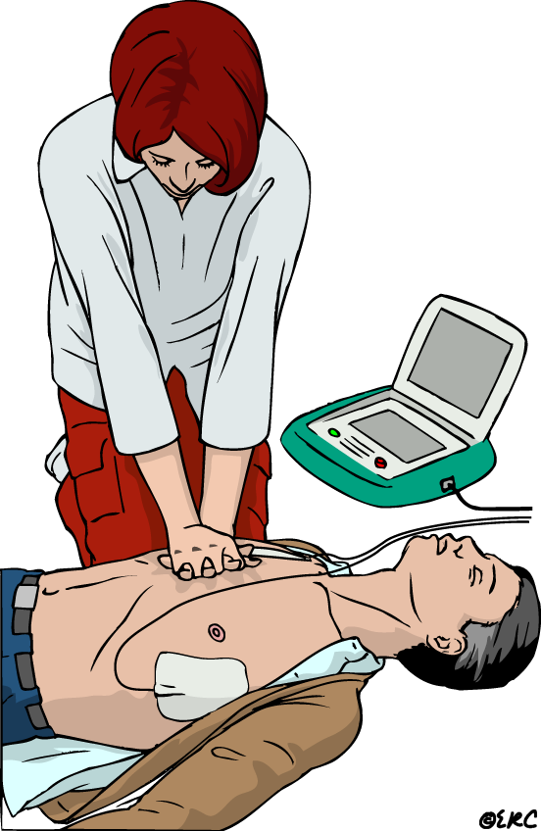
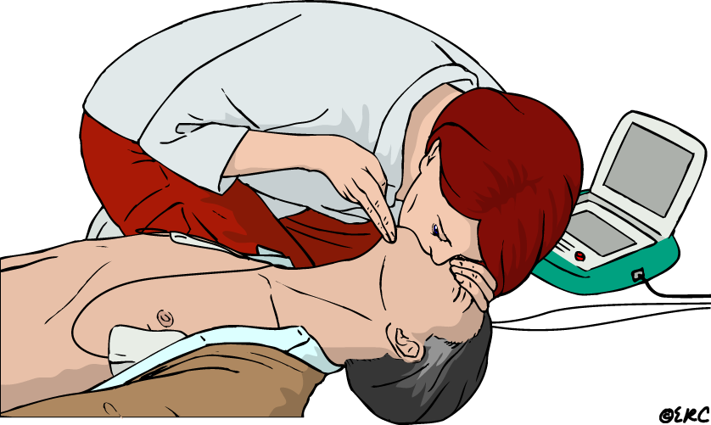
1. SHOCK DELIVERED resume CPR immediately for 5 cycles
30 2
Notes:
61

Slide 62
2. NO SHOCK ADVISED resume CPR immediately for 5 cycles
30 2
Notes:
62

Slide 63
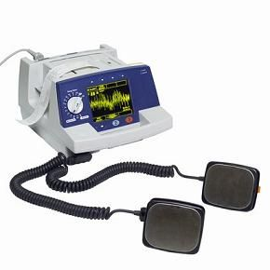

Slide 65
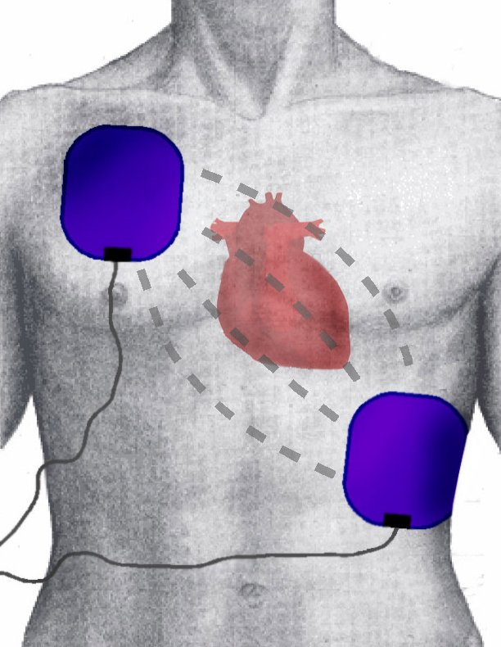

Slide 66
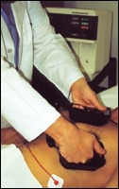

Slide 67
RECOVERY POSITION
Notes:
67

Slide 68
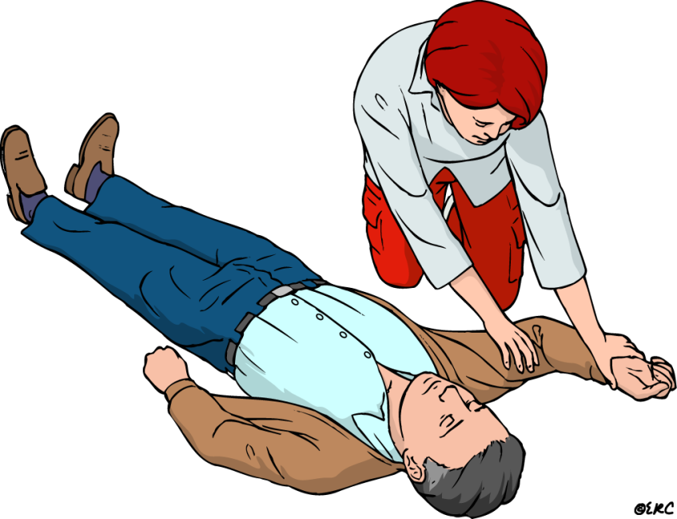
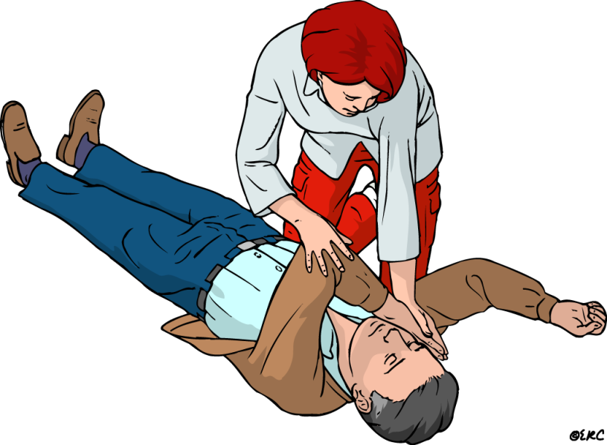
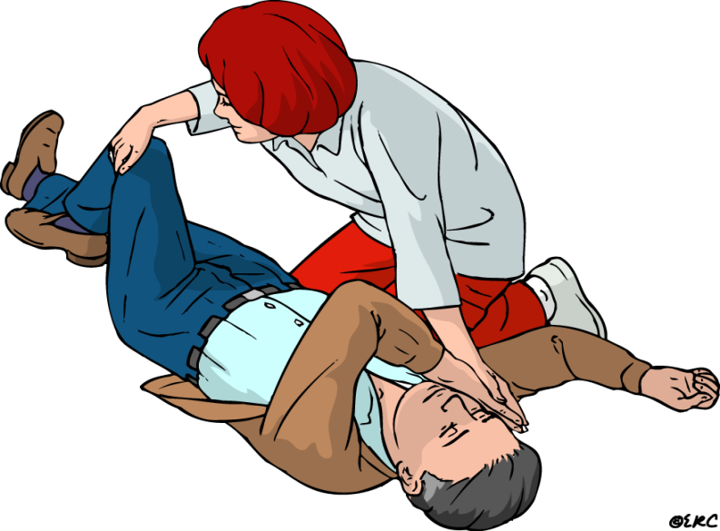
Recovery position
1
2
4
3
Notes:
68

Slide 69
ADVANCED CARDIAC LIFE SUPPORT (ACLS)

Slide 72
ایست قلبی بدون نبض
VF
VT
فعالیت الکتریکی بدون نبض( PEA)
آسیستول

Slide 73
Survival from these arrest rhythms requires:
BLS and ACLS

Slide 74
witnessed VF arrest, prompt bystander:
1.CPR
2.Early defibrillation

Slide 75
Route ACCESS FOR
MEDICATION

Slide 76
IV Access for Medications:
Central line access
Drugs typically require 1 to 2 minutes to reach the central circulation when given via a peripheral vein but require less time when given via central venous access

Slide 77
peripheral venous route:
Follow with a 20 ml bolus of IV fluid
Elevate the extremity for 10 to 20 seconds to facilitate drug delivery to the central circulation

Slide 78
Intraosseous (IO) cannulation
provides access to a noncollapsible venous plexus, enabling drug delivery similar to that achieved by central venous access

Slide 79
endotracheal route (VALEN)
Vasopressin
Atropine
Lidocaine
Epinephrine
Naloxone
2-2.5 times the recommended IV dose
dilute with 5-10mL of water/normal saline

Slide 80
Pulseless arrest

Slide 81
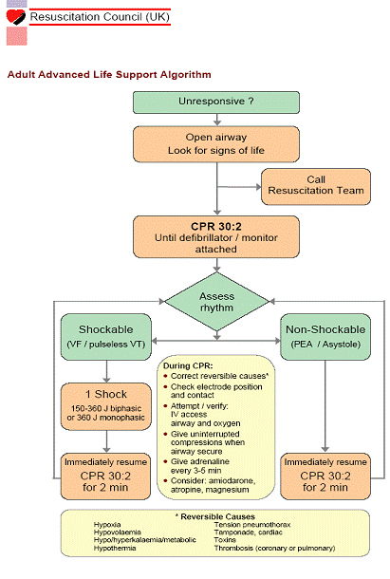

Slide 84
ASYSTOLE / PEA

Slide 85
Asystole
complete cessation of myocardial electrical activity
End-stage rhythm
Asystole should always be confirmed in at least two limb leads
It may be difficult to distinguish between extremely fine VF and asystole

Slide 87
Pulseless Electrical Activity
PEA is defined as non-coordinated groups of electrical activity of the heart (other than VT/VF) without a palpable pulse
EMD: no myocardial contractions occur
Pseudo-EMD: myocardial contractions occur but no pulse can be palpated

Slide 88
5T’s :
توکسین
تامپوناد
پنوموتوراکس فشارنده
ترومبوز (کورونری یا ریوی)
تروما / هیپوولمی
5H’s :
هیپوولمی
هیپوکسی
هیدروژن (اسیدوز)
هیپرکالمی/هیپوکالمی/هیپوگلیسمی
هیپوترمی

Slide 90
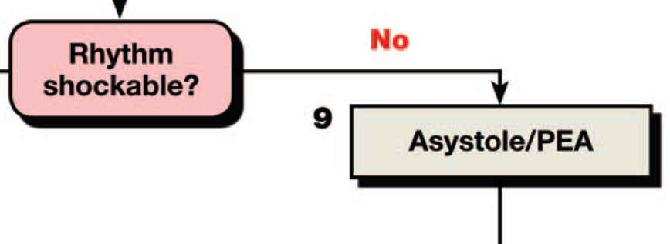

Slide 94
VT / VF

Slide 96
What is this?

Slide 97
Polymorphic VT

Slide 100
Medications for Arrest Rhythms
1-Epinephrine
2-Amiodarone
3-Lidocaine
4-Magnesium

Slide 101
IV ACCESS FOR
MEDICATION

Slide 102
IV Access for Medications:
Central line access is not needed in most resuscitation attempts.
Drugs typically require 1 to 2 minutes to reach the central circulation when given via a peripheral vein but require less time when given via central venous access.

Slide 103
peripheral venous route:
Follow with a 20 ml bolus of IV fluid
Elevate the extremity for 10 to 20 seconds to facilitate drug delivery to the central circulation.

Slide 104
Intraosseous (IO) cannulation provides access to a noncollaps-ible venous plexus, enabling drug delivery similar to that achieved by central venous access.

Slide 105
If IV and IO access cannot be established, some resuscitation drugs may be administered by the endotracheal route

Slide 106
E T route:
Vasopressin
Atropine
Lidocaine
Epinephrine
Naloxone
VALEN

Slide 107
The optimal endotracheal dose of most drugs is unknown, but typically the dose given by the endotracheal route is 2 to 2.5 times the recommended IV dose.

Slide 108
Providers should dilute the recommended dose in
5 to 10 mL of water or normal saline

Slide 109
Drug:
Anti arrhythmics :
Amiodarone :
300 mg first dose
if needed after 15-20 min,
150 mg max, 450 mg
Lidocaine :
1.5 mg/kg first dose
if needed Q 10 min--- 0.75 mg/kg for 2 doses max. 3 mg/kg
Vasopressors :
Epinephrine :
NS rhythms
1 mg- IV, ET
Q 3-5 min/ cont to END

Slide 110
Drug :
As a law:
Drugs injections in CPR must be:
PUSH
ETT administration:
2 - 2.5 times as IV doses
plus
5-10 ml distilled water

Slide 111
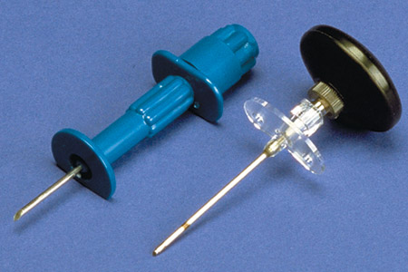
Alternative IV Sites and Techniques
Intraosseous (IO) needles
Used for emergency venous access when other IV access is difficult or impossible
Often patients are experiencing a life-threatening situation.
Generally inserted in the proximal tibia

Slide 112
Magnesium
When VF/pulseless VT cardiac arrest is associated with torsades de pointes, providers may administer magnesium sulfate at a dose of 1-2g diluted in 10mL D5W IV/IO push, typically over 5 -20 minutes

Slide 116
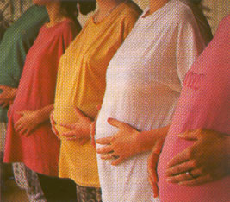
RESUSCITATION OF THE PREGNANT PATIENT

Slide 117
احیای مادر باردار :
پوزیشن مادر باردار در طول احیا
نقش زایمان سزارین پیش از مرگ ( PMCD ) در احیا مادران در نیمه دوم بارداری

Slide 118
موقعیت شیب جانبی چپ برای مادر باردار در حین احیا

Slide 119
Lateral Uterine Displacement
در صورتی که ارتفاع فوندوس رحم بالاتر یا در سطح ناف باشد ، LUD دستی می تواند در رفع فشار ورید اجوف تحتانی و آئورت شکمی ( Aortocaval ) در حین ماساژهای قفسه سینه مفید باشد.

Slide 120
During resuscitation there are two patients, mother & fetus
The best hope of fetal survival is maternal survival
Consider the physiologic changes due to pregnancy

Slide 121
Successful resuscitation of a pregnant woman & survival of the fetus require prompt & excellent CPR with some modifications in techniques
By the 20th week of gestation, the gravid uterus can compress the IVC & aorta, obstructing venous return & arterial blood flow
Rescuers can relieve this compression by positioning the woman on her side or by pulling the gravid uterus to the side

Slide 122
Defibrillation
Defibrillate using standard ACLS defibrillation doses
There is no evidence that shocks from a direct current defibrillator have adverse effects on the heart of the fetus
If fetal or uterine monitors are in place, remove them before delivering shocks

Slide 123
Summary
Defibrillation & medication doses used for resuscitation of the pregnant woman are the same as those used for other adults
Rescuers should consider the need for ER Caesarian Delivery as soon as the pregnant woman develops cardiac arrest
Rescuers should be prepared to proceed if the resuscitation is not successful within 4 minutes

Slide 124
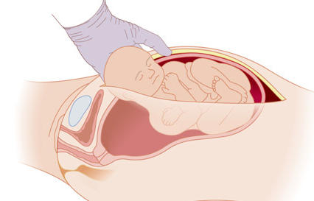
Perimortem cesarean delivery (PMCD)

Slide 128
در چه زمانی عملیات احیا را شروع نکنیم ؟
اگر بیمار نشانه های آشکار مرگ را داشت:
جمود نعشی که 6 تا 10 ساعت پس از مرگ پیدا میشود (سفت شدن بدن)
کبودی وابسته به جاذبه
گندیدگی (فساد) یا تجزیه بدن
وجود شواهدی از آسیبهای غیر قابل برگشت به زندگی :
جدا شدن سر از بدن
سوختگی های شدید که شناسایی مصدوم ممکن نباشد

Slide 129
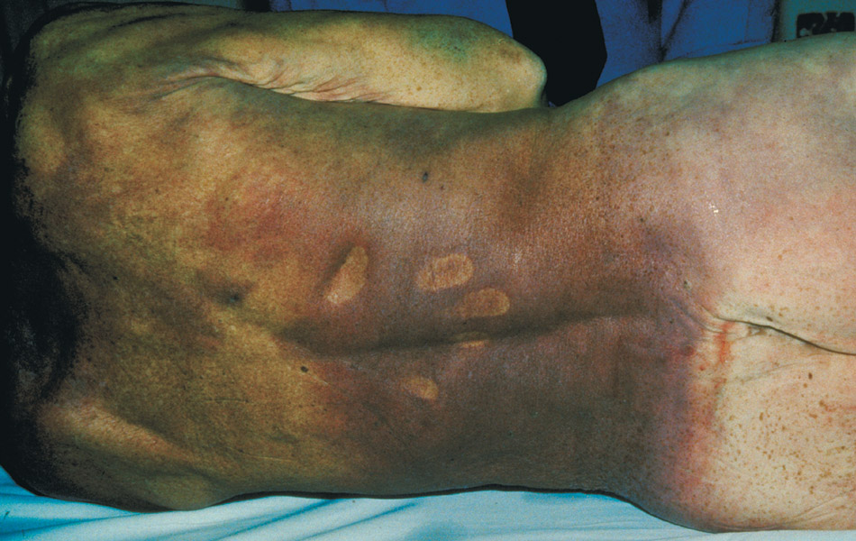
در چه زمانی عملیات احیا را شروع نکنیم ؟
کبودی وابسته به جاذبه

Slide 130
ECMO

Slide 135
2020 Guideline Updates

Slide 136
Adult CPR

Slide 149
Pediatric/Neonatal CPR

