Slide 1
ادامه اسلاید ها- 3

Slide 2
Excessive Ventilation
Impedes venous return & therefore decreases CO, & coronary perfusion by increasing intra-thoracic pressure
Causes air trapping & baro-trauma in patients with small airway obstruction
Increases the risk of regurgitation & aspiration

Slide 3
Gastric Inflation & Cricoid Pressure
Apply cricoid pressure. Do this only in an unresponsive victim & if there is a second rescuer. Avoid excessive pressure so as not to obstruct the trachea.

Slide 4
Coordinate Chest Compressions and Ventilations
A lone rescuer uses a compression-to-ventilation ratio of 30:2.
For 2-rescuer infant and child CPR, one provider should perform chest compressions while the other keeps the airway open and performs ventilations at a ratio of 15:2
Deliver ventilations with minimal interruptions in chest compressions

Slide 5
Coordinate Chest Compressions and Breathing
No advanced airway in place: pause after 30 compressions (1 rescuer) or 15 compressions (2 rescuers) to give 2 ventilations when using either mouth-to-mouth or bag-mask technique
An advanced airway in place: chest compression at a rate of 100 per min w/o pauses for ventilations, & ventilation at a rate of 8-10 bpm
Change the compressor role approximately q 2 min (ideally in < 5 s) to prevent compressor fatigue & deterioration in quality & rate of chest compressions.
Notes:
An dvanced airway is one of this :intubation , tracheostomy or LMA insertion

Slide 6
Defibrillation
Using an AED in infants < 1 y/o?
Use a standard AED if an AED with a pediatric attenuating system is not available.
Notes:
چند جمله در مورد AED ,

Slide 7
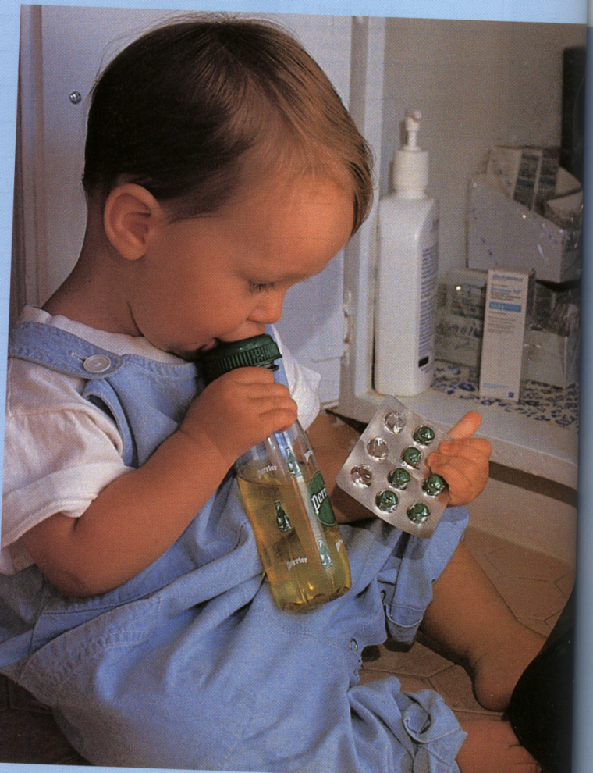
Foreign Body Airway Obstruction chocking

Slide 8
FBAO (Choking)
Epidemiology & Recognition
  More than 90% of deaths occur in children < 5 y/o.
  Signs: a sudden onset of respiratory distress with coughing, gagging, stridor, or wheezing

Slide 9
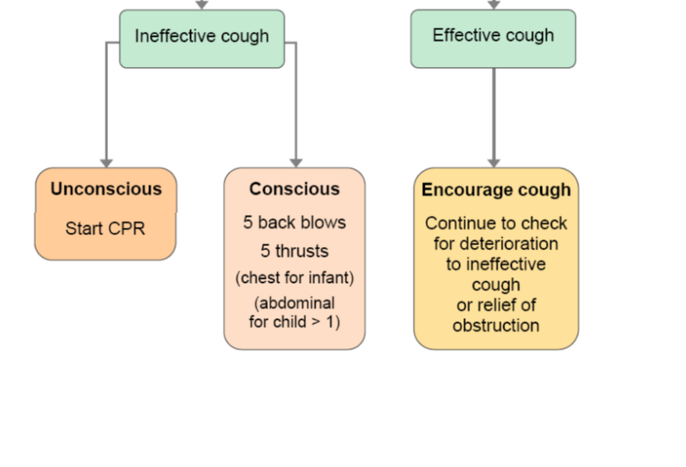
FBAO (Choking)
Mild airway obstruction
  The child can cough & make some sounds.
Severe airway obstruction
  The victim cannot cough or make any sound.

Slide 10
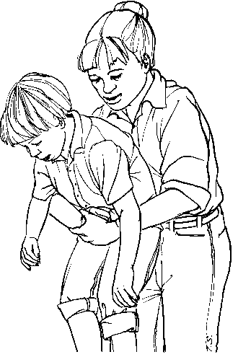
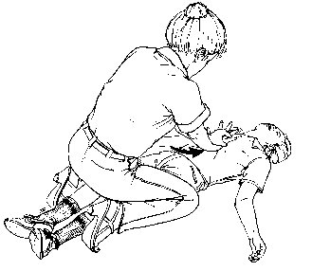
Heimlich maneuver
Conscious Child Standing
Conscious or Unconscious Child, Lying

