Slide 1
ادامه اسلاید احیاء- 2

Slide 2


Pediatric Basic Life Support
© 2010 American Heart Association
http://www.circulationaha.org

Slide 3
Ventilations
Inadequate Breathing With Pulse
After 30 compressions (15 compressions if 2 rescuers),open the airway with a head tilt– chin lift and give 2breaths. If there is evidence of trauma that suggests spinal injury, use a jaw thrust without head tilt to open the airway

Slide 4
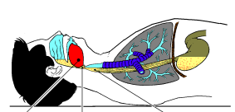
Nonresponsive tongue & epiglottis block airway

Slide 5
Cervical Spinal Precautions
For a healthcare provider with suspecting a C-spine injury: jaw thrust without head tilt
Use a head tilt– chin lift maneuver if the jaw thrust does not open the airway.
Notes:
a lay rescuer uses a head tilt–chin lift maneuver for both injured and noninjured victims

Slide 6
Opening the Airway
Airway obstruction produced by the tongue & the epiglottis
Relief by head-tilt/chin-lift

Slide 7
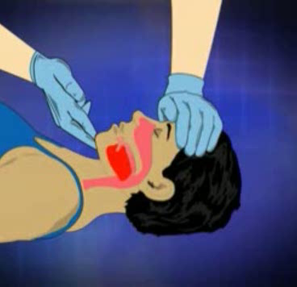

Slide 8
Jaw-thrust Maneuver

Slide 9
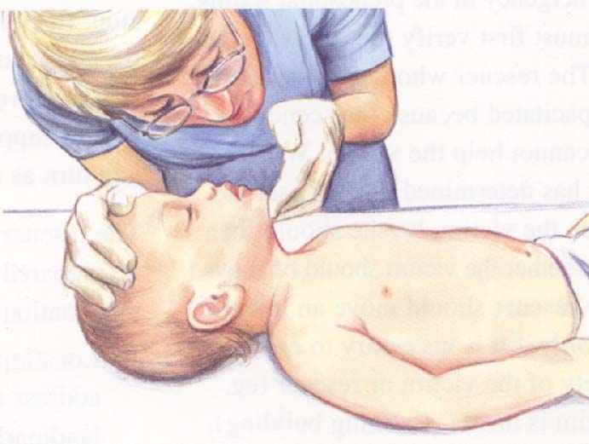
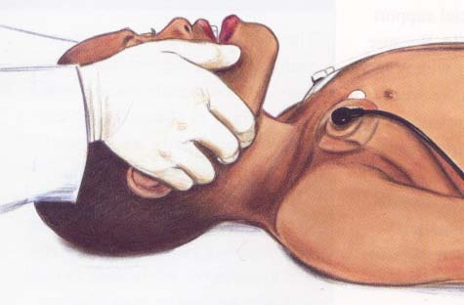
Airway Management
Head Tilt-Chin Lift
Jaw Thrust
Avoid extreme hyperextension

Slide 10
Correct (sniffing) position for maximal airway patency

Slide 11
Rescue Breathing
Maintain an open airway & give 2 breaths.
  Make sure that the breaths are effective (i.e., the chest rises).
  If the chest does not rise, reposition the head, make a better seal, & try again.

Slide 12
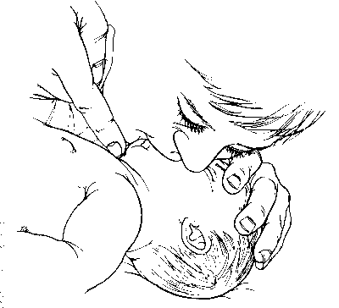
Comments on Technique
In an infant, use a mouth-to–mouth-&-nose technique .
In a child, use a mouth-to-mouth technique.
If you use the mouth-to-mouth technique, pinch the nose closed.
If you use the mouth-to-nose technique, close the mouth.

Slide 13
Barrier Devices
Despite its safety, some healthcare providers & lay rescuers may hesitate to give mouth-to-mouth rescue breathing & prefer to use a barrier device.
Barrier devices have not reduced the risk of transmission of infection, & some may increase resistance to air flow.
If you use a barrier device, do not delay rescue breathing.

Slide 14
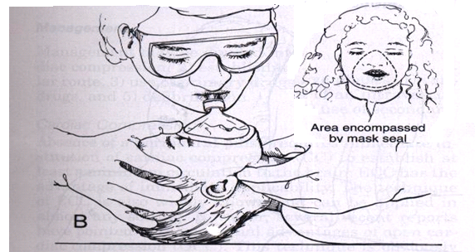

Slide 15
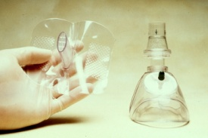

Slide 16
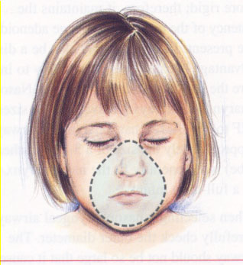
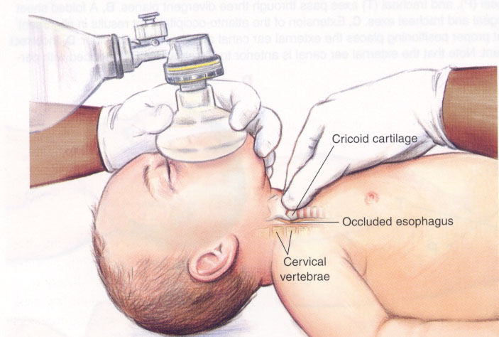
Bag-Mask Ventilation
Can be as effective as ETI & safer when providing ventilation for short periods
In the out-of-hospital setting, preferentially ventilate & oxygenate infants & children with a bag & mask rather than attempt intubation if transport time is short .

Slide 17
Ventilation Bags
Use a self-inflating bag with a volume of at least 450-500 ml.
Even with an oxygen inflow of 10 L/min, the concentration of delivered oxygen varies from 30-80%.
To deliver a high oxygen concentration (60-95%), attach an oxygen reservoir to the self-inflating bag.
You must maintain an oxygen flow of 10-15 L/min into a reservoir attached to a pediatric bag & a flow of at least 15 L/min into an adult bag.

Slide 18
Precautions
Avoid hyperventilation; use only the force & VT necessary to make the chest rise.
Give each breath over 1 s.

