Slide 1

Pediatric Chain of Survival
1.prevention,
2.early CPR,
3.prompt access to the emergency response system,
4.rapid PALS,
5. integrated post– cardiac arrest care.
the first 3 links: BLS
Notes:
1- since injury is the leading cause of death in children over 1 year of age and motor vehicle crashes are the most common cause of fatal childhood injuries; targeted interventions, such as the use of child passenger safety seats, can reduce the risk of death.

Slide 2
Overall about 6% of children who suffer an out-of-hospital cardiac arrest and 8% of those who receive prehospital emergency response resuscitation survive

Slide 3
RESCUERS
Lay Rescuers
Healthcare Providers

Slide 4
VICTIMS
INFANT:<1Y/O
CHILD:1Y/O until puberty (defined as breast development in females and the presence of axillary hair in males)
ADULT:beyond puberty

Slide 5
Safety
Safety of Rescuer & Victim
Always make sure that the area is safe for you & the victim.
Move a victim only to ensure the victim’s safety.
Notes:
,a high way, a burning building ,

Slide 6
Assess Responsiveness
Call the child’s name if you know it,or ask loudly: “Are you okay?”
Tap the victim (the bottom of the foot is a good place in infant & ).
Look for movement,answering or moaning

Slide 7
Responsive child
he or she will answer or move.
Checking the child for any injuries or need of medical assistance
Calling EMS

Slide 8
Nonresponsive
(Shout for help, check breath)
Regular breathing
No evidence of trauma
Breathing but respiratory distress
Recovery position
Call EMS
Remain him/her in a position that is most comfortable
Call EMS

Slide 9
Recovery Position
If the child is breathing & there is no evidence of trauma: turn the child onto the side (recovery position).

Slide 10
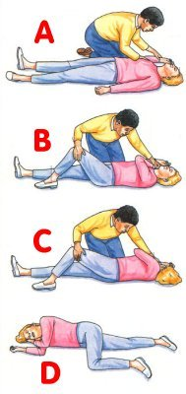
Recovery Position

Slide 11
Unresponsive
No Breathing or Gasping
Start CPR.
Lone rescuer, continue CPR for 5 cycles (about 2 min)then call EMS
Two rescuers:one continues CPR and other call EMS

Slide 12
Unresponsive child
If you are alone & there is no evidence of trauma, you may carry a small child with you to the telephone.
If the child must be moved for safety reasons, support the head & body to minimize turning, bending, or twisting of the head & neck.

Slide 13
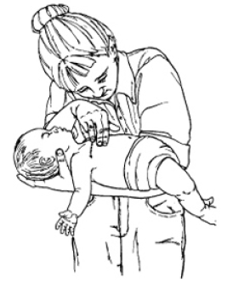
carrying a small child to the telephone

Slide 14
Activate the EMS System & Get the AED
If the arrest is witnessed & sudden (e.g., an athlete who collapses on the playing field), a lone healthcare provider should activate the EMS system & get an AED before starting CPR
If two rescuers,one continues CPR and the other activates EMS
If one rescuer and the arrest is not witnessed,continue CPR for 2 min then activate EMS

Slide 15
Position the Victim
If the victim is unresponsive, make sure that the victim is in a supine position on a flat, hard surface, such as a sturdy table, the floor, or the ground.
If you must turn the victim, minimize turning or twisting of the head & neck.

Slide 16
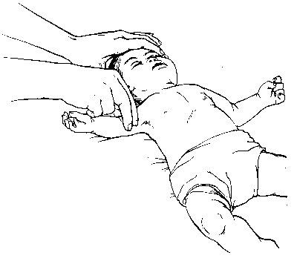
Pulse Check
Brachial in an infant & carotid or
femoral in a child
Take no more than 10 s
Profound bradycardia [PR < 60 bpm + signs of poor perfusion (i.e., pallor, cyanosis)] despite oxygenation & ventilation: chest compressions

Slide 17
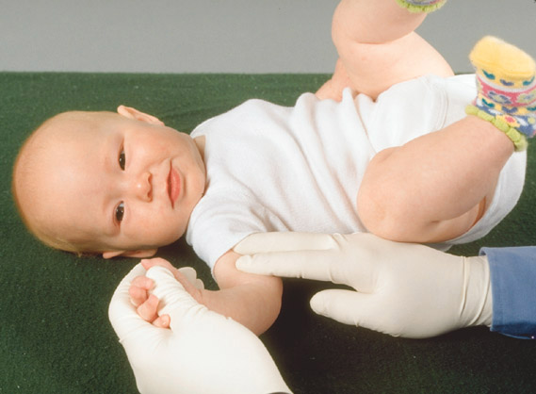
BRACHIAL PULSE CHECK

Slide 18
Definite pulse
Give one breath every 3-5 seconds(12-20/min)
Open the airway using a head tilt–chin lift maneuver or jaw thrust
(lay rescuers use head tilt–chin lift maneuver for both injured and noninjured victims)

Slide 19
No pulse
Do chest compression &
breathing

Slide 20
When check pulse again
Reassess the pulse about every 2 minutes but spend no more than 10 seconds

Slide 21
Chest Compressions
Compress the lower half of the sternum.
Do not compress over the xiphoid.
After each compression allow the chest to recoil fully to improve blood flow into the heart.
Lift your hand slightly off the chest at the end of each compression.

Slide 22
Chest Compressions
“Push hard”: to depress the chest approximately 1/3 the anterior-posterior diameter of the chest
Compress 4cm in infant & 5 cm in >1yr
“Push fast”: at a rate of at least 100 compressions/min.
Release completely to allow the chest to fully recoil.
Minimize interruptions in chest compressions.

Slide 23
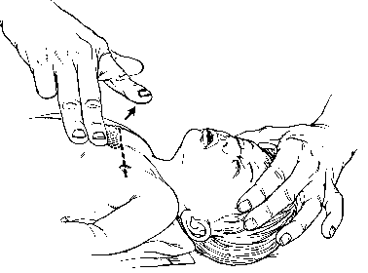
2-finger Chest Compression Technique in Infant
For lay rescuers & lone rescuers
Place 2 fingers just below the inter-mammary line.

Slide 24
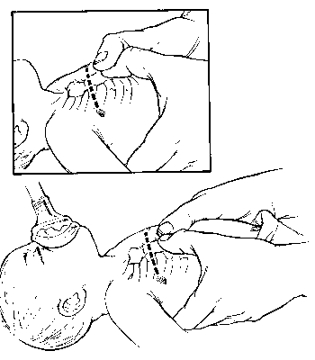
Hand Position for Chest Encirclement
Encircle the infant’s chest with both hands; spread your fingers around the thorax, & place your thumbs together over the lower half of the sternum.
Forcefully compress the sternum with your thumbs .
Notes:
The 2-thumb–encircling hands technique is preferred over the 2-finger technique because it produces higher coronary artery perfusion pressure, results more consistently in appropriate depth or force of compression,and may generate higher systolic and diastolic pressures

Slide 25
2 Thumb–encircling Hands Chest Compression in Infant (2 Rescuers)

Slide 26
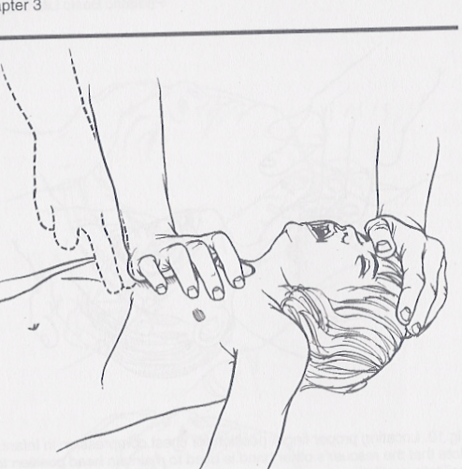
Chest Compressions
In older children → the lower third of the sternum
Maintain continuous head tilt with hand on forehead
One hand
100/minute
1/3 of chest

Slide 27
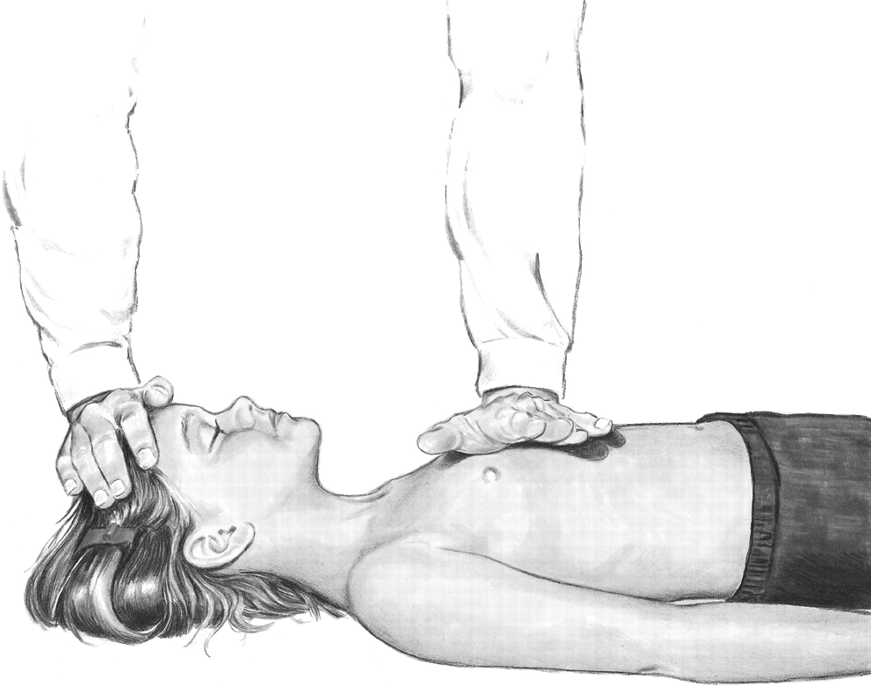
One-hand chest compression technique in child (1-8) Yr
Copyright ©2000 American Heart Association

Slide 28
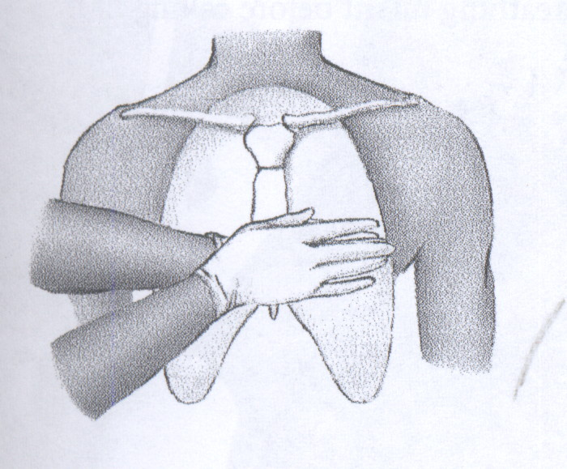

Slide 29
