Slide 2
Hypertension in Pregnancy

Slide 3
Preeclampsia
Multidisystem
Progressive disorder
Hypertension and proteinuria
or
Hypertension and end organ dysfunction ± P

Slide 4
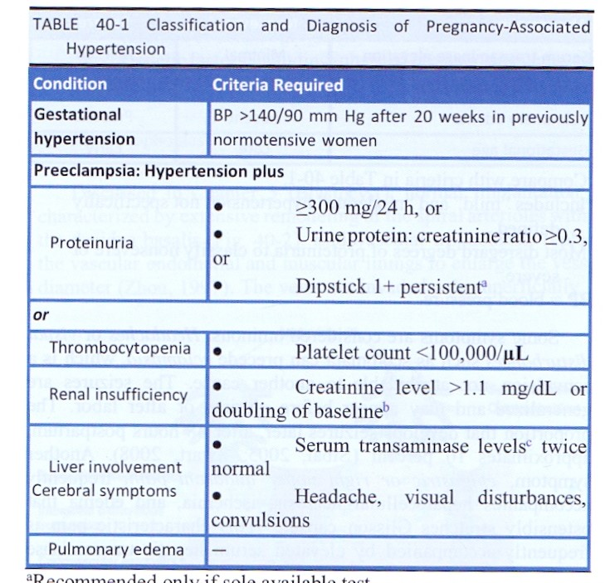

Slide 6
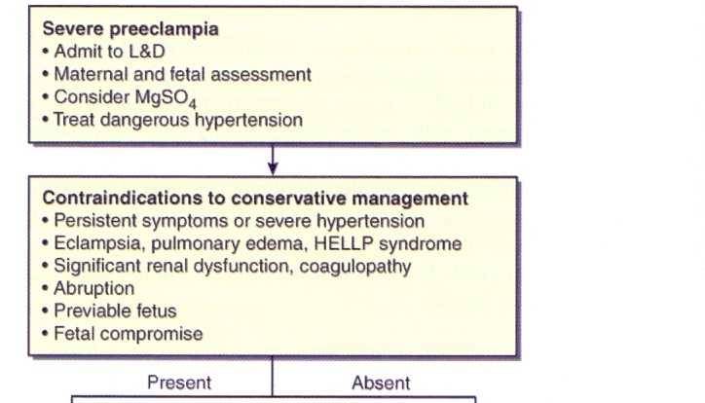

Slide 7
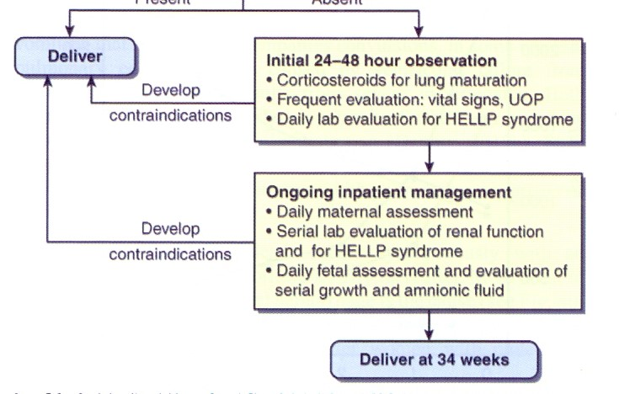

Slide 8
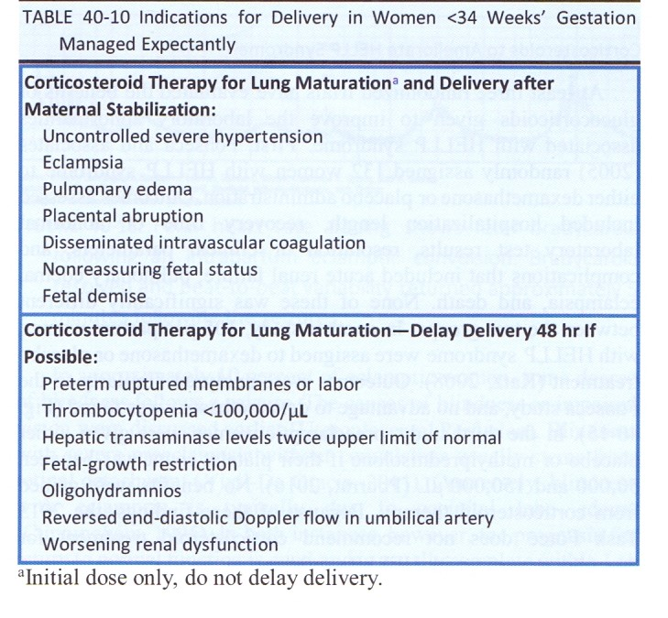

Slide 10
Cerebral-H
Hepatic-Rupture
Renal Failure
Pulmunary Edema
Seizure
Bleeding (Plt)
Myocardial infarction
Stroke
ARDS
Retinal detachment P-ab F-complication

Slide 11
Cardiovascular
Chronic hypertension
Ischemic heart disease
Atherosclerosis
Coronary artery calcification
Cardiomyopathy
Thromboembolism
Neurovascular
Stroke
Retinal detachment
Diabetic retinopathy

Slide 12
Metabolic
Type 2 diabetes
Metabolic syndrome
Dyslipidemia
Obesity
Renal
Glomerular dysfunction
Proteinuria
Central nervous system
White-matter lesions
Cognitive dysfunction
Retinopathy

Slide 13
Definitive treatment delivery
Severity
M-F Condition
Gestation age

Slide 14
Expectant Management
≥37 wk
Unstable M-F
24≥ >34

Slide 15
با سپاس

