Slide 1


Slide 2
Clinical Practice Guideline on management of patients with diabetes and chronic kidney disease stage 3b or higher (eGFR <45 mL/min)
Dr. Amir Reza Goharian
Endocrinologist
26/3/1401

Slide 3


Slide 4
Diabetes mellitus is becoming increasingly prevalent and is considered a rapidly growing concern for healthcare systems.
Besides the cardiovascular complications, diabetes mellitus is associated with Diabetic kidney disease (DKD).

Slide 5
CKD in patients with diabetes can be caused by true diabetic nephropathy, but can also be caused indirectly by diabetes, e.g. due to:
polyneuropathic bladder dysfunction
increased incidence of relapsing urinary tract infections
macrovascular angiopathy.

Slide 6
However many patients who develop CKD due to a cause other than diabetes will develop or may already have diabetes mellitus.
Finally,
many drugs that are used for management of CKDs, e.g. corticosteroids or calcineurin inhibitors, can caus diabetes.
Despite the strong interplay between diabetes and CKD, the management of patients with diabetes and CKD stage 3b or higher (eGFR <45 mL/min) remains problematic.

Slide 8
Renoprotection

Slide 9
ADA 2022
For patients with type 2 diabetes and diabetic kidney disease, use of a sodium–glucose cotransporter 2 inhibitor in patients with an estimated glomerular filtration rate ≥25 mL/min/1.73 m2 and urinary albumin ≥ 300 mg/g creatinine is recommended to reduce chronic kidney disease progression and cardiovascular events. ( A )

Slide 10
ADA 2022
In patients with type 2 diabetes and chronic kidney disease, consider use of sodium–glucose cotransporter 2 inhibitors additionally for cardiovascular risk reduction when estimated glomerular filtration rate and urinary albumin creatinine are ≥ 25 mL/min/1.73 m2 or ≥ 300 mg/ g, respectively (Fig. 9.3). (A)

Slide 11
ADA 2022
11.4 Optimize blood pressure control to reduce the risk or slow the progression of chronic kidney disease. A
11.5 Do not discontinue renin-angiotensin system blockade for minor increases in serum creatinine (<30%) in the absence of volume depletion. B
11.6 For people with non-dialysis dependent chronic kidney disease, dietary protein intake should be # 0.8 g/kg body weight per day (the recommended daily allowance). A
☻For patients on dialysis, higher levels of dietary protein intake should be considered, since malnutrition is a major problem in some dialysis patients. B

Slide 12
ADA 2022
11.9 An ACE inhibitor or an angiotensin receptor blocker is not recommended for the primary prevention of chronic kidney disease in patients with diabetes who have normal blood pressure, normal urinary albumin-to- creatinine ratio (<30 mg/g Cr), and normal estimated glomerular filtration rate. A
11.10 Patients should be referred for evaluation by a nephrologist if they have an estimated glomerular filtration rate <30 mL/min/1.73 m2. A
11.11 Promptly refer to a physician experienced in the care of kidney disease for uncertainty about the etiology of kidney disease, difficult management issues, and rapidly progressing kidney disease. A

Slide 13
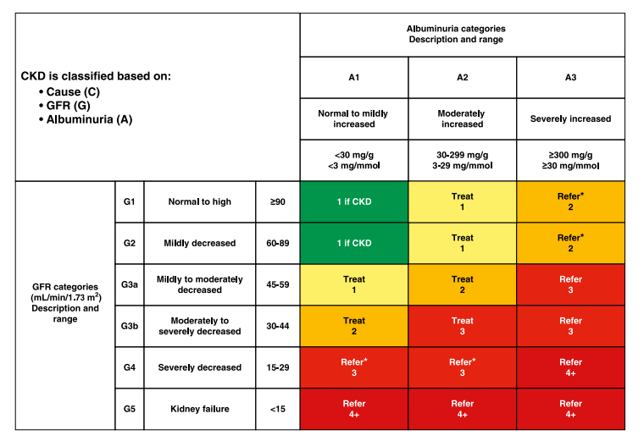

Slide 14
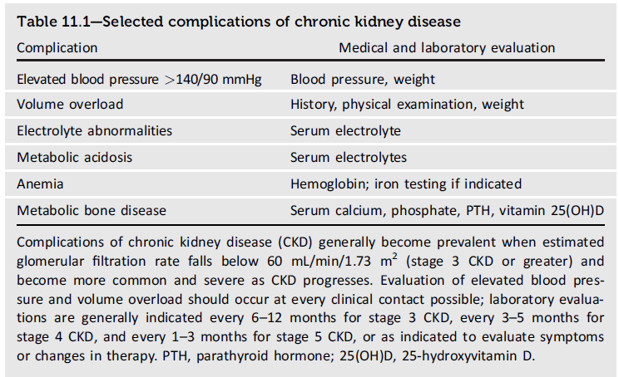

Slide 15
CHAPTER 1:
ISSUES RELATED TO RENAL
REPLACEMENT MODALITY SELECTION
IN PATIENTS WITH DIABETES AND
END-STAGE RENAL DISEASE

Slide 16
Should patients with diabetes and CKD
stage 5 start with peritoneal dialysis or
hemodialysis as a first modality?

Slide 17
We recommend:
We recommend giving priority to the patient’s general status and preference in selecting renal replacement therapy as there is an absence of evidence of superiority of one modality over another in patients with diabetes and CKD stage 5 (1C).
We recommend providing patients with unbiased information about the different available treatment options (1A).

Slide 18
Should patients with diabetes and CKD
stage 5 start dialysis earlier, i.e. before
becoming symptomatic, than patients
without diabetes?

Slide 19
We recommend:
We recommend initiating dialysis in patients with diabetes on the same criteria as in patients without diabetes (1A).

Slide 20
In patients with DM and CKD stage 5 should a native fistula, graft or tunnelled catheter be preferred as initial access?

Slide 21
We recommend:
We recommend that reasonable effort be made to avoid tunnelled catheters as primary access in patients with diabetes starting HD as renal replacement therapy (1C).
We recommend that the advantages, disadvantages and risks of each type of access be discussed with the patient.

Slide 22
Is there a benefit to undergoing
renal transplantation for patients
diabetes and CKD stage 5?

Slide 23
We recommend:
We recommend providing education on the different options of transplantation and their expected outcomes for patients with diabetes and CKD stage 4 or 5 who are deemed suitable for transplantation (1D).

Slide 24
Statements only for patients with type 1 diabetes and CKD stage 5
We suggest:
living donation kidney transplantation or simultaneous pancreas kidney transplantation to improve survival of suitable patients (2C).
We suggest against:
islet transplantation after kidney transplantation with the aim to improve survival (2C).
We suggest:
pancreas grafting to improve survival after kidney transplantation (2C).

Slide 26
Statements only for patients with type 2 diabetes and CKD stage 5
We recommend against :
pancreas or simultaneous kidney pancreas transplantation (1D).
We recommend:
Diabetes in itself should not be considered a contraindication to kidney transplantation in patients who otherwise comply with inclusion and exclusion criteria for transplantation(1C).

Slide 27
CHAPTER 2
ISSUES RELATED TO GLYCAEMIC CONTROL IN PATIENTS WITH DIABETES AND CKD STAGE 3B OR HIGHER (eGFR <45 mL/min)

Slide 28
Should we aim to lower HbA1C by tighter glycemic control in patients with diabetes and CKD stage 3b or higher (eGFR <45 mL/min?
Is an aggressive treatment strategy (in number of injections and controls and follow-up) superior to a more relaxed treatment strategy in patients with diabetes and CKD stage 3b or higher (eGFR <45 mL/min) and using insulin?

Slide 29
We recommend:
We recommend against:
tighter glycaemic control if this results in severe hypoglycaemic episodes (1B).
We recommend:
vigilant attempts to tighte glycaemic control with the intention to lower HbA1C,
when values are >8.5% (69mmol/mol)(1C).

Slide 30
Severity of hypoglycaemic episodes are defined as ‘mild’ when it can be treated by the patient himself and as ‘severe’when assistance is required.
The most important concern is
to avoid episodes of hypoglycaemia.
Empower patients at moderate and high risk for hypoglycaemia to perform regular follow-up of blood glucose level by using validated point of care devices.

Slide 31
It is unclear whether in this specific patient cohort, aiming at a lower HbA1C value by tightening glycaemic control results in improved outcomes, in terms of mortality and morbidity.
There is some concern that excess mortality and morbidity can be induced by increasing the risk for (severe) hypoglycaemia.

Slide 32
What did we find?
We found one recent systematic review in dialysis patients on the association between HbA1C and outcome that included 10 studies (83, 684 participants) (9 observational studies and 1 secondary analysis of a randomized trial).
Likewise, patients with a mean HbA1c value>8.5% had a higher adjusted risk of mortality (HR 1.29; 95% CI 1.23–1.35).
In incident patients, mean HbA1c value <36 mmol/mol (5.4%) were also associated with increased mortality risk (HR 1.29; 95% CI 1.23–1.35).

Slide 33
In the general population, tight glycaemic control does not result in improvement of all-cause and cardiovascular mortality,but results in an increased risk for hypoglycaemia.
As in CKD stage 3b or higher (eGFR <45 mL/min), the risk of hypoglycaemia is enhanced and the survival benefit is probably lower due to the general lower life expectancy, tight HbA1C control is probably even less relevant in this patient cohort.

Slide 34
On the other hand, observational data show that lower HbA1C is associated with better outcome, so at least one should (cautiously) try to lower HbA1C,
if this can be obtained without increasing the risk for hypoglycaemia.

Slide 35
We recommend:
We recommend intense self-monitoring only to
avoid hypoglycaemia in patients at high risk for
hypoglycaemia (2D).

Slide 36
self-monitoring can not be recommended if the only aim is to reduce HbA1C.
However, in patients at risk for hypoglycaemia i.e. mostly those taking active medication with a high risk of hypoglycaemia, e.g. insulin, regular monitoring should be performed to avoid overshooting and hypoglycaemia.
The risk for hypoglycaemia outweighs the potential benefits of reduced microvascular complications in patients with advanced stages of CKD.

Slide 37
Are there better alternatives than HbA1c to estimate glycaemic control in patients with diabetes and CKD stage 3b or higher (eGFR <45 mL/min/ 1.73 m2)?

Slide 38
We recommend:
We recommend the use of HbA1C as a routine reference to assess longer term glycaemic control in patients with CKD stage 3b or higher (eGFR <45 mL/min/1.73 m2) (1C).

Slide 39
The following factors are potentially associated with a lower than expected HbA1C:
decreased red blood cell survival
increased red blood cell formation (use of iron, RhuEpo).
The following factors are potentially associated with a higher than expected HbA1C:
▪ accumulation of uraemic toxins.

Slide 40
`
Due to the availability of relatively inexpensive and routinely measured HbA1c assays and the inconsistent or limited data to prove the superiority of other glycaemic markers (glycated albumin, fructosamine, 1,5-AG and continuous glucose monitoring) at this time, the guideline development group judges that:
HbA1c should remain the reference standard for glycaemic monitoring in patients with diabetes and CKD stage 3b or higher (eGFR <45 mL/min).

Slide 41
At now,
continuous subcutaneous glucose monitoring
( CGM )seems to be a promising method to correctly evaluate glycaemic control in patients with diabetes undergoing HD and in whom more intense glycaemic control is judged to be of relevance.

Slide 42
However, one should take into account that a reduction of the glycaemia-lowering effect of sulphonylurea over time is common, due to islet cell exhaustion.
Many of these drugs require progressive dose reduction with progression of CKD, and some are contraindicated in CKD stage 5.
In dialysis patients, the glinides should generally be avoided.

Slide 43
Exenatide is cleared by proteolytic activity after glomerular filtration, and its clearance is therefore strongly diminished in patients with impaired renal function.
As a consequence, its use is not recommended in CKD stage 3b or higher (eGFR <45 mL/min/1.73 m2).

Slide 44
guideline group judges that adding a DPP4-I to metformin seems to be safe in terms of hypoglycaemia risk, and does not result in an increase of weight, but on the other hand, the expected benefit in terms of hard endpoints is low.
Sitagliptin, vildagliptin, alogliptin and saxagliptin all require dose reduction in CKD, whereas
linagliptin does not .

Slide 45
CHAPTER 3
ISSUES RELATED TO MANAGEMENT OF CARDIOVASCULAR RISK IN PATIENTS WITH DIABETES AND CKD STAGE 3B OR HIGHER

Slide 46
In patients with diabetes and CKD stage 3b or higher or on dialysis and with CAD, is PCI ,CABG or conservative treatment to be preferred?

Slide 47
We recommend:
We recommend not omitting coronary angiography with the sole intention of avoiding potential contrast-related deterioration of kidney function in patients with diabetes and CKD stage 3b or higher (eGFR<45mL/min) in whom a coronary angiography is indicated (1D).
We recommend that optimal medical treatment should be considered as preferred treatment in patients with diabetes and CKD stage 3b–5 who have stable CAD, unless there are large areas of ischaemia or significant left main or proximal LAD lesions (1C).

Slide 48
We recommend:
We recommend that when a decision is taken to
consider revascularization, CABG is preferred
over PCI in patients with multivessel or complex
(SYNTAX score >22) CAD .
We recommend that patients with diabetes and CKD stage 3b or higher (eGFR <45 mL/min) who present with an acute coronary event should be treated no differently than patients with CKD stage 3b or higher (eGFR <45 mL/min) without diabetes or patients with diabetes without CKD stage 3b or higher (1D).

Slide 49
In patients with diabetes and CKD stage 3b or higher or on dialysis and with a cardiac indication (CHF, IHD, HTN) should we prescribe inhibitors of the RAAS system as cardiovascular prevention?

Slide 50
We recommend:
We recommend that adults with CKD stage 3b or higher (eGFR <45 mL/min/1.73 m2 or on dialysis) and diabetes who have a cardiovascular indication (heart failure, ischaemic heart disease) be treated with an ACE-I at maximally tolerated dose (1B).
We suggest there is insufficient evidence to justify the start of an angiotensin-receptor blocker (ARB) in adults with CKD stage 3b or higher (eGFR <45 mL/min/1.73 m2 or on dialysis) and diabetes who have a cardiovascular indication (heart failure, ischaemic heart disease) but intolerance for ACE-I (2B).

Slide 51
There is insufficient evidence whether or not RAAS inhibitors should be stopped in patients with CKD progressing to CKD stage 5.
In patients with CKD stage 3–5, death is a more likely outcome than progression to ESRD.
Diabetes is a multiplier of CVD risk. Therefore, in this particular population, drugs that would slow progression of renal disease and at the same time be cardioprotective appear as a theoreticaly
‘first-line’ therapy.

Slide 52
Blockers of the RAA system are both renoprotective and cardioprotective in the general population.
However, in patients with diabetes and CKD stage 3b or higher, this potential benefit may be more limited or be counterbalanced by the need to start dialysis earlier (e.g. because of hyperkalaemia, or sudden deterioration of renal function).

Slide 53
It can thus be questioned whether, in this specific subpopulation starting an RAAS blocker in patients who have a cardiac indication, is justified.
Only patients treated with maximally tolerated doses of ACE-I versus placebo, had a survival benefit ( RR 0.78, 95% CI 0.61–0.98), but not those treated at lower doses of ACE-I (RR1.18, 95% CI 0.41–3.44) or with ARBs (RR 0.99, 95% CI 0.85–1.17) in a Cochrane review.

Slide 54
The present data on withdrawing RAAS inhibitors in patients already taking them for a cardiac indication when their CKD progresses to an eGFR <30 mL/min/1.73 m2 are controversial, and no randomized trials on this intervention are available.
However, observational data, even in patients without diabetes, suggest that in patients with an eGFR <30 mL/min, the risk for hyperkalaemia is 6.8 (95% CI 2.7–17.4) times higher than in patients with an eGFR >50 mL/min.

Slide 55
The guideline development group judges that it thus makes sense to discuss the withdrawal of an RAAS inhibitor with patients whose eGFR progresses to <15 mL/min, in an attempt to delay the need for start of renal replacement therapy.

Slide 56
We recommend:
We recommend not combining different classes of renin angiotensin-blocking agents (ACE-I, ARBs or direct renin inhibitors) (1A).

Slide 57
In patients with diabetes and CKD stage 3b or higher or on dialysis, should we prescribe beta blockers to prevent sudden cardiac death?

Slide 58
We suggest:
We suggest starting a selective beta-blocking agent as primary prevention in patients with diabetes and CKD stage 3b or higher and then continuing it when tolerated (2C).
We suggest prescribing lipophilic rather than hydrophilic beta-blocking agents in patients with diabetes and CKD stage 3b or higher (eGFR<45 mL/min) (2C).

Slide 59
Sudden cardiac death is an important cause of mortality in patients with CKD stage 3b or higher and in patients with diabetes.
Ventricular re-entrant circuits and fibrosis-ischaemia are likely to be part of this paradigm, together with electrolyte disturbances and other explanation.

Slide 60
It is appreciated that beta blockers can have an important role in several cardiac situations, e.g. ventricular rate control and heart failure.
The question is whether or not the routine prescription of these drugs, with their known side effects, can provide a survival advantage in patients with diabetes with CKD stage 3b or higher (eGFR <45 mL/min).

Slide 61
guideline development group judges that congestive heart failure is quite prevalent in our target population, and that therefore, the results are very likely to also apply in our population.
Based on these considerations, the guideline development group judged that it was logical to apply the same recommendations in patients with diabetes and CKD stage 3b or higher (eGFR <45mL/min) as in patients with diabetes without CKD or in patients with CKD without diabetes.

Slide 62
In patients with diabetes and CKD stage 3b or higher, should we aim at lower BP targets than in the general population?

Slide 63
We suggest:
We suggest against applying lower blood pressure targets in patients with diabetes and CKD stage 3b or higher (eGFR <45 mL/min/1.73 m2) than in the general population (2C).
We suggest that in patients with diabetes and CKD stage 3b or higher (eGFR <45 mL/min/1.73 m2) but without proteinuria, all blood pressure-lowering drugs can be used equally to lower blood pressure (2C).

Slide 64
In patients with diabetes and CKD stage 3b or on dialysis, should we prescribe
lipid-lowering therapy in primary prevention?

Slide 65
We recommend:
We recommend starting a statin in patients with diabetes and CKD stage 3b and 4 (1B).
We suggest a statin be considered in patients with diabetes and CKD stage 5 (2C).
In these patients, lipid-lowering treatment resulted in a non-significant 8% risk reduction of the primary endpoint of major vascular events.

Slide 66
We recommend:
We recommend against starting a statin in patients with diabetes and CKD stage 5D (1A).
There was a non-significant 8% risk reduction of the primary endpoint of CV death, non-fatal MI and stroke.
Therefore, the guideline group judged that there is no general recommendation to initiate statins in dialysis dependent patients with diabetes.

Slide 67
Doses of lipid-lowering agents should be adapted according to renal function.
We should be considered maximal doses in patients with CKD, repetitive measurement of lipid levels does not add diagnostic or therapeutic value.

Slide 68
There was no consensus in the guideline development group on whether or not statins should be stopped in patients with diabetes with CKD stage5D.
We suggest fibrates can replace statins in patients with CKD stage 3b who do not tolerate statins (2B).

Slide 69
In patients on dialysis, moderate- to high-quality evidence indicated that statins had little or no effect on all-cause mortality (RR 0.96; 95% CI 0.88–1.04), cardiovascular mortality (RR 0.94; 95% CI 0.82–1.07) or cardiovascular events (RR 0.95; 95% CI 0.87–1.03).
Effects of statins in kidney transplant recipients were uncertain.

Slide 70
In patients with DM and CKD stage 3b or higher, should we recommend interventions aimed at increasing energy expenditure and physical activity?

Slide 71
We suggest:
We suggest that patients with diabetes and CKD stage 3b or higher (eGFR <45 mL/min) perform additional physical exercise at least three times 1/2 to 1 hour/week to reduce fat mass and improve QoL (2D).
When promoting weight loss in patients with diabetes and with overweight, we recommend supervision of this process by a dietician and to ensure that only fat mass is lost and malnutrition is avoided (1C).

Slide 72
In patients with diabetes and CKD stage 3b or higher should antiplatelet therapy be recommended, regardless of the cardiovascular risk?

Slide 73
We recommend starting aspirin as secondary prevention, unless there is a contraindication, side effects or intolerance (1C).
We suggest starting aspirin as primary prevention only in patients without additional risk factors for major bleeding (2C).

Slide 74

سپاس از توجه شما

