Slide 1
Basic Life Support (BLS)
In the name of God
Presented by:
Morteza Ghaderi
MSN - EMS Educator
PhD Student of Health in Disaster and Emergencies

Slide 2
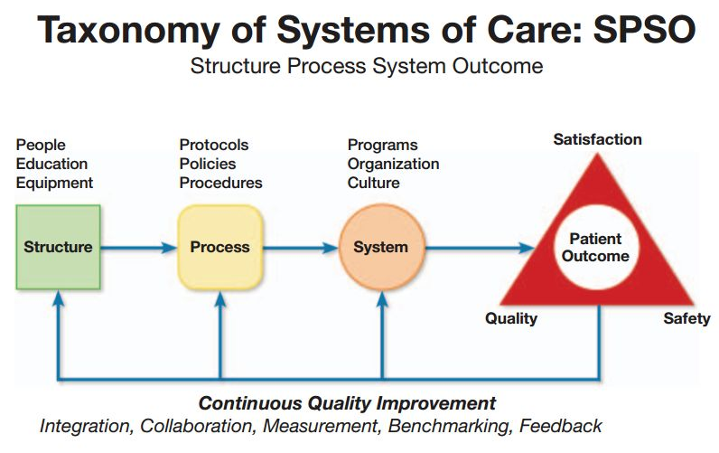

Slide 5
شانس زنده ماندن به ازاء هر دقیقه عدم درمان به شدت کاهش می یابد
4-0 دقیقه
اگر احیاء شروع شود احتمال آسیب مغزی کم است
6-4 دقیقه
آسیب مغزی ممکن است
10-6 دقیقه
آسیب مغزی احتمال دارد
0
4
6
10
بیش از 10دقیقه
آسیب شدید مغزی یا مرگ مغزی

Slide 9
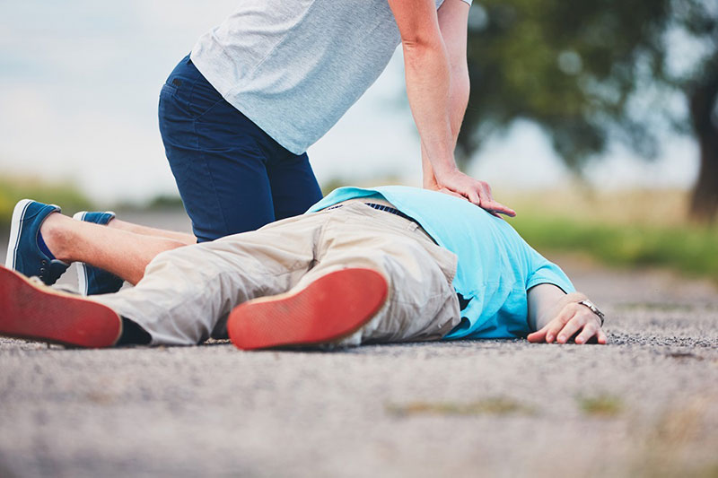
Adult Basic Life Support Algorithm for Healthcare Providers

Slide 12
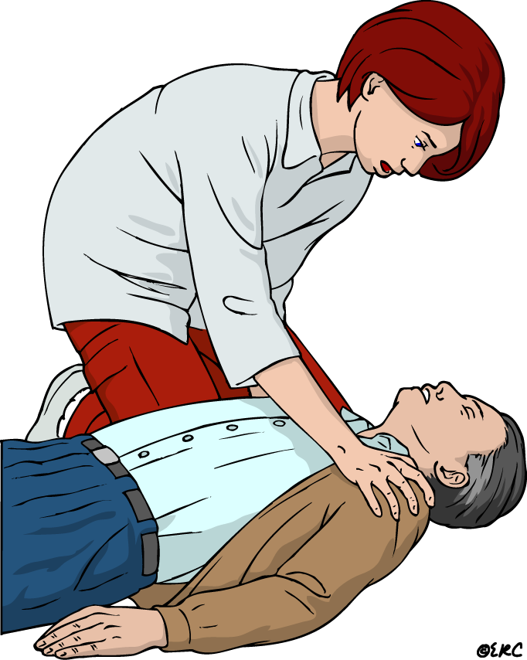
CHECK RESPONSE & SHOUT FOR HELP

Slide 14
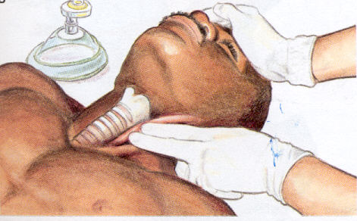
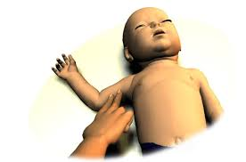
Check pulse
Only for healthcare provider
Feel within
10 sec

Slide 18
Start CPR When …… :
Unresponsiveness
Abnormal
Breathing
Or
No breathing
Start CPR

Slide 19
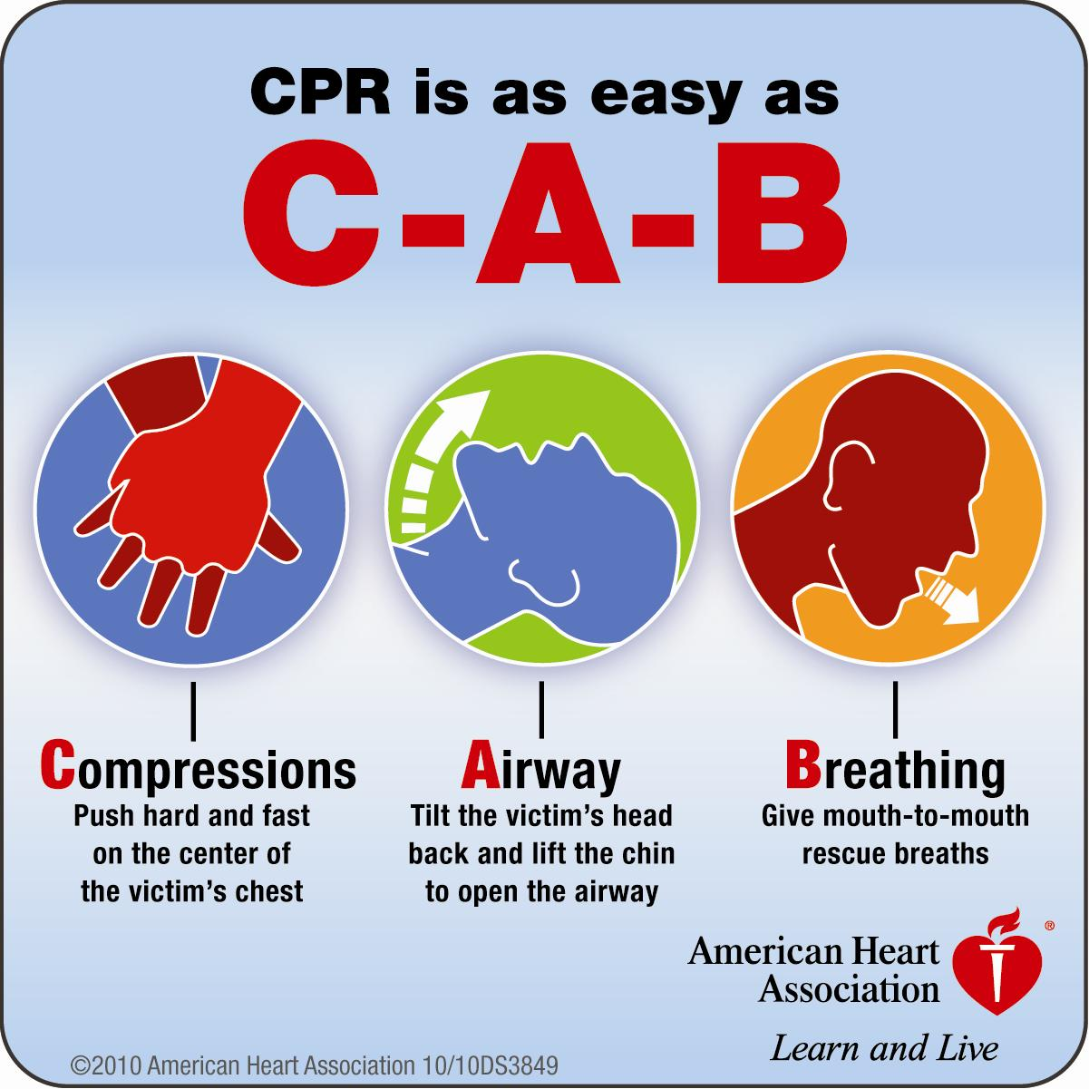

Slide 20
CHEST COMPRESSIONS

Slide 21
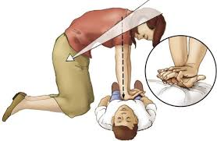
CHEST COMPRESSIONS
In adult
Push hard and fast the chest
Rate 100-120 /min
Depth 5-6 cm
Minimize interruptions in chest compressions.
When possible change CPR operator every 2 min

Slide 22
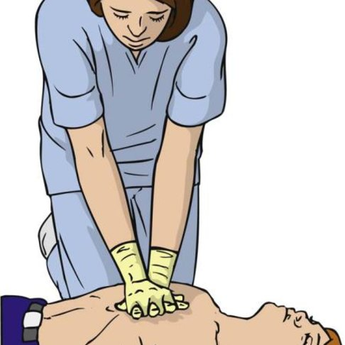
CHEST COMPRESSION
In Child

Slide 23
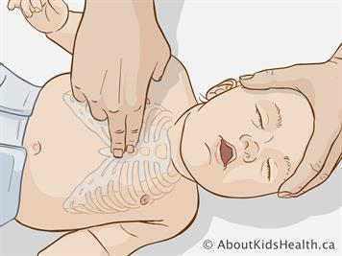
CHEST COMPRESSION
In infant

Slide 24
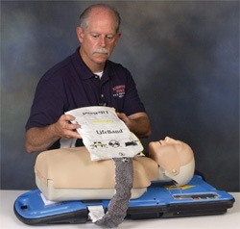
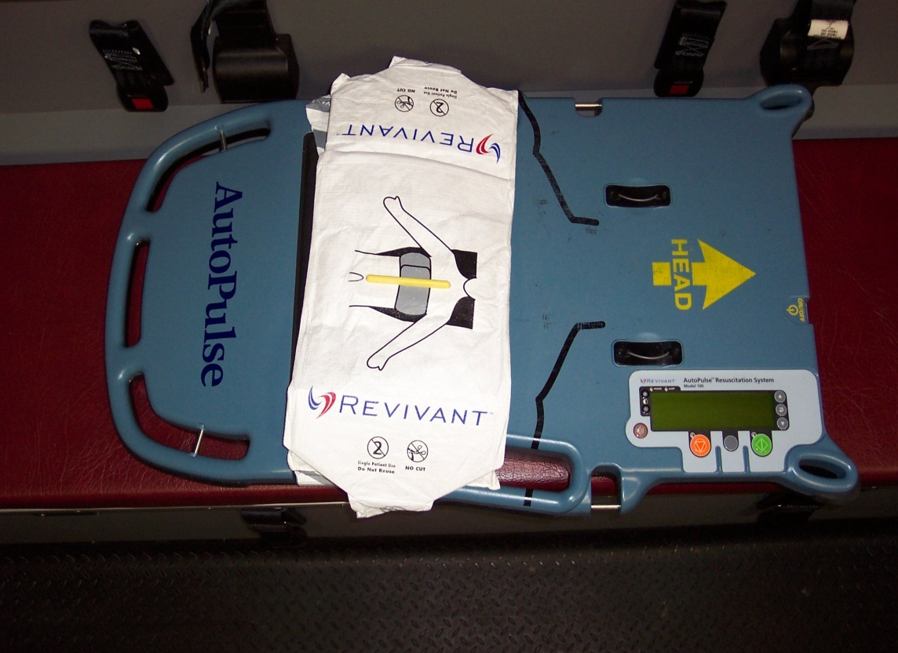
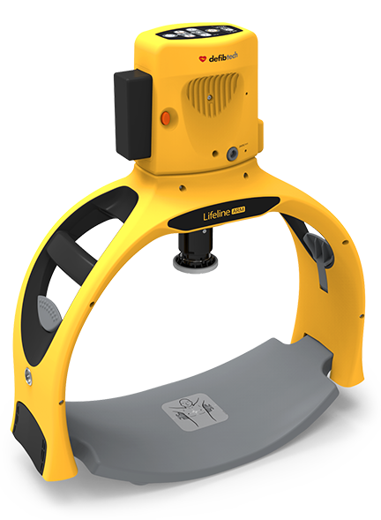
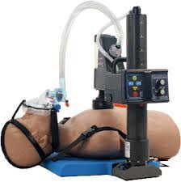
Mechanical Chest Compression Devices

Slide 25
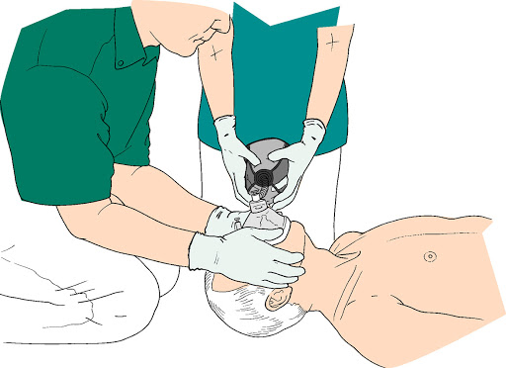
Compressions To Ventilations Ratio
30
2

Slide 26
C.T.V. ratio
1 rescuer 2 rescuer
Adult < 8 yr.
30 : 2 30:2 15:2

Slide 27
Head Tilt- Chin Lift

Slide 28
Jaw Thrust

Slide 29
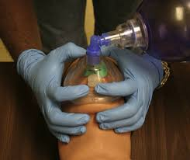
E-C clamp technique

Slide 31
Automated External Defibrillator (AED)

Slide 32
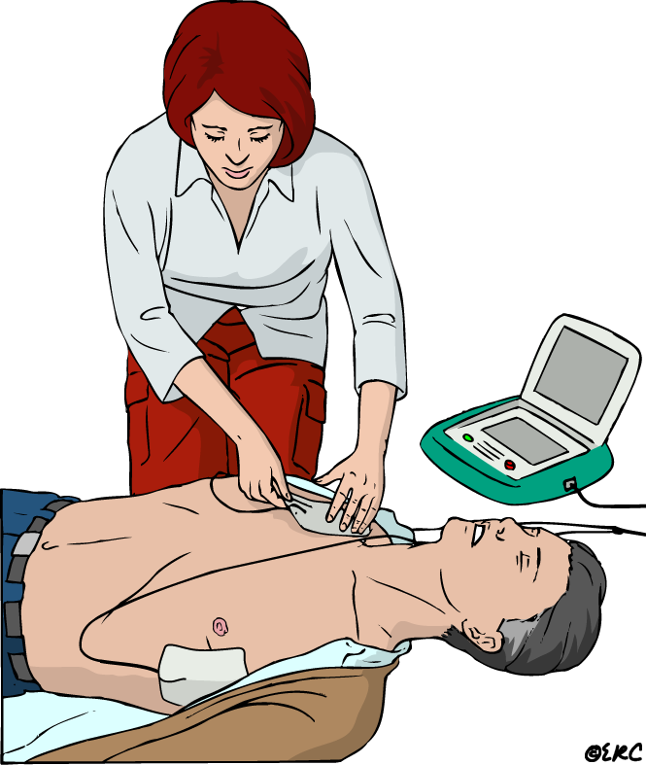
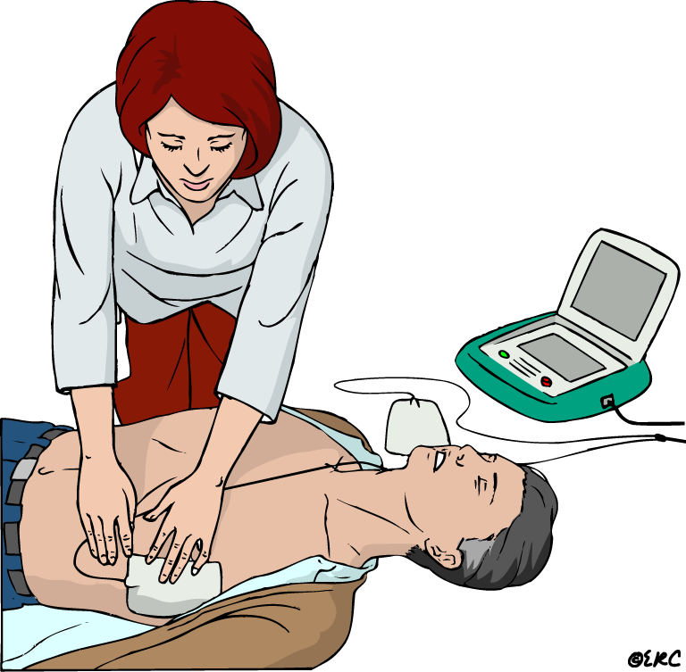
Attach AED to Patient

Slide 33
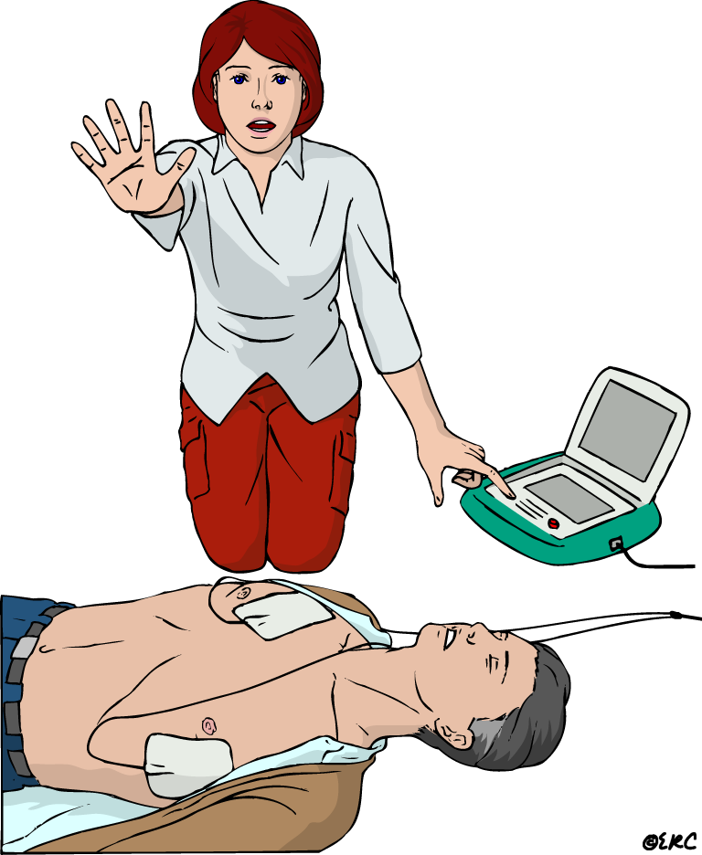
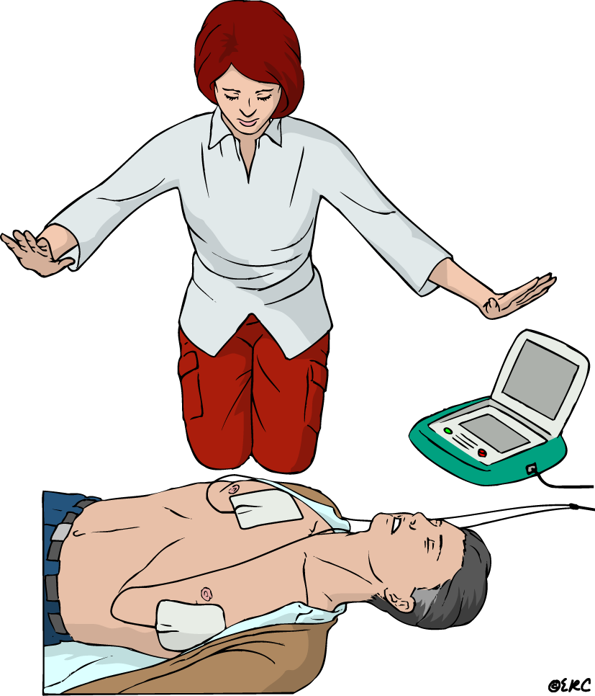
Analyze - Once clear - Deliver a shock

Slide 34
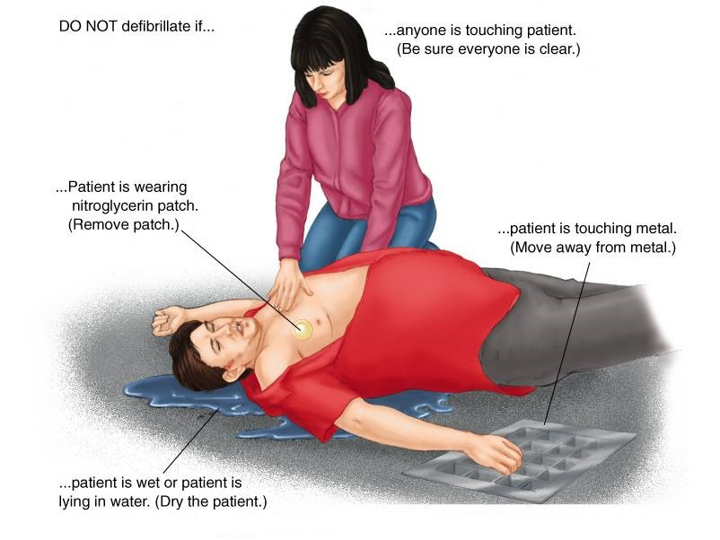

Slide 35
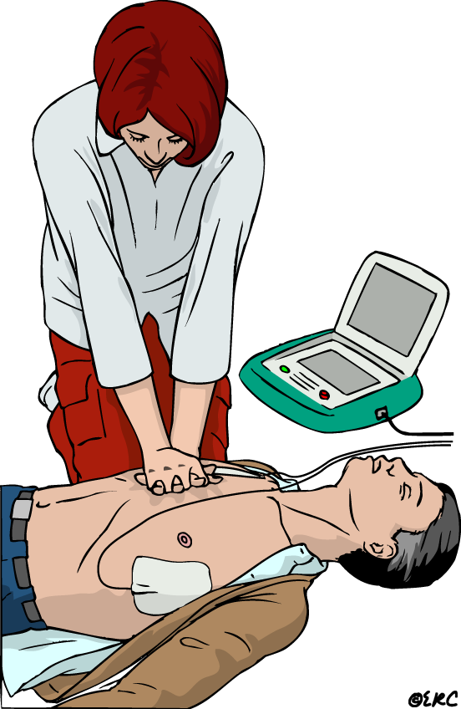
Resume CPR immediately

Slide 39
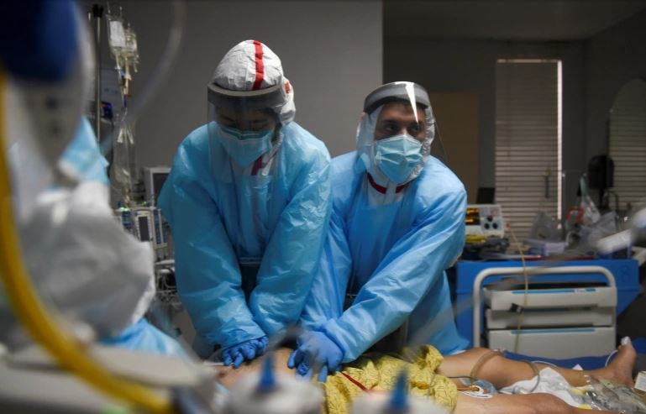
BLS Healthcare Provider Adult Cardiac Arrest Algorithm for Suspected or Confirmed COVID-19 Patients

Slide 41
BLS Healthcare Provider Adult Cardiac Arrest Algorithm for Suspected or Confirmed COVID-19 Patients

Slide 45
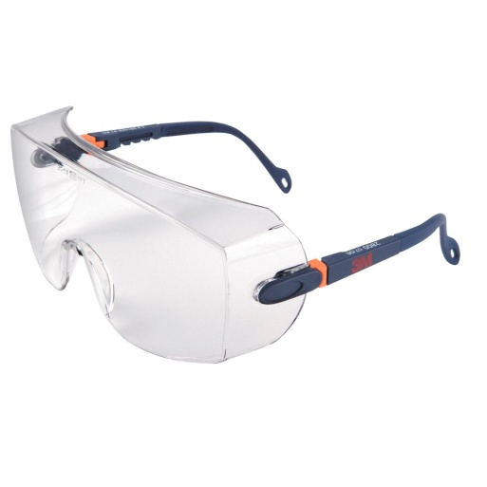
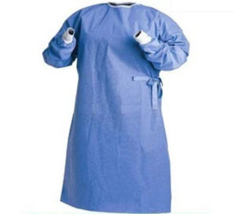
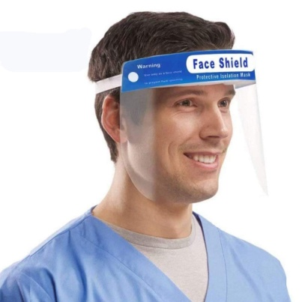

Slide 46
BLS Healthcare Provider Adult Cardiac Arrest Algorithm for Suspected or Confirmed COVID-19 Patients

Slide 49
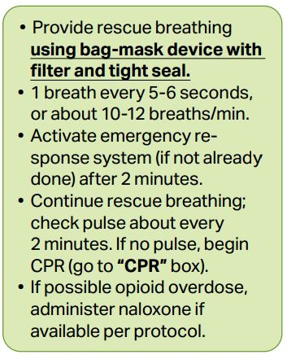

Slide 51
High-efficiency particulate air (HEPA)

Slide 52
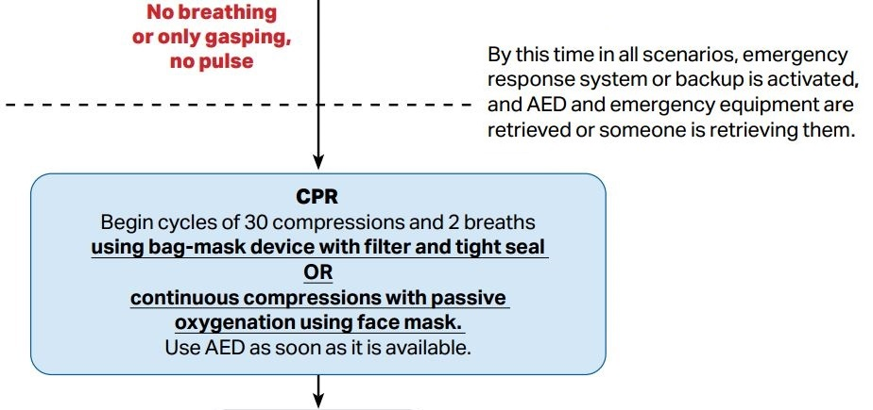

Slide 53
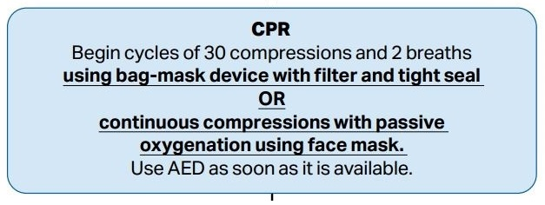

Slide 54
HANDS ONLY CPR

Slide 55
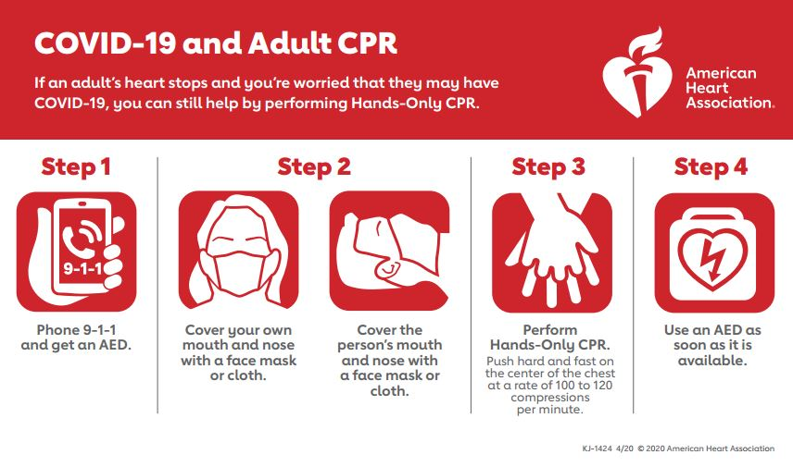

Slide 56
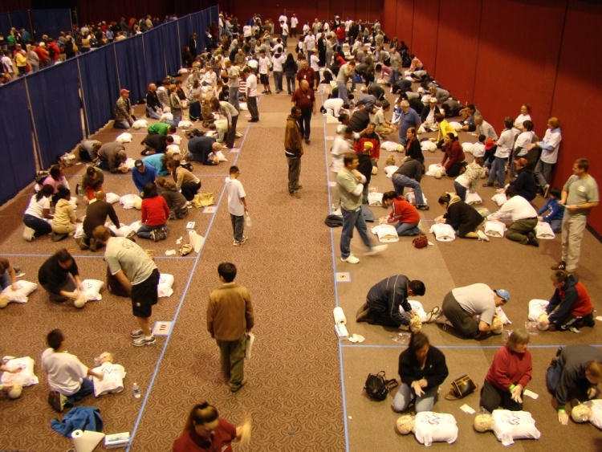
Thank you for your attention
Good luck

