Slide 2
Sepsis in pregnancy

Slide 3
Case report
31 y , G2Ab1 , second marriage, 19w
Second inf. 7yr→ spontaneous pregnancy
PNC: in private clinic
PSH:curettage,laparascopy,rhinoplasty
LMP:95/2/16
8-19 w→ 6times→PNC

Slide 4
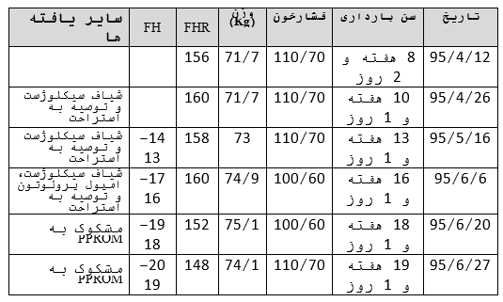
Case report

Slide 5
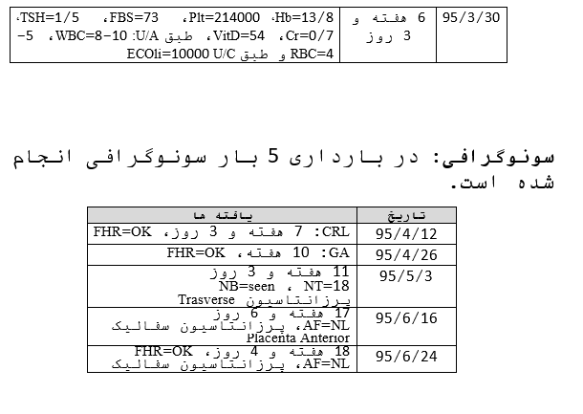
Case report
97/6/1

Slide 6
Case report
95/6/20
CC:ROM (18w)→ no documentation for work up
95/6/24
ROM→sono→AFI:5.12cm→advise for rest
ROM → hospitalization
95/6/28

Slide 7
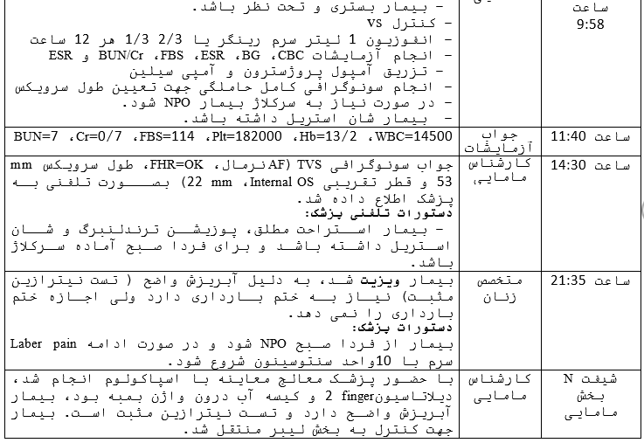
Case report
97/6/1

Slide 8
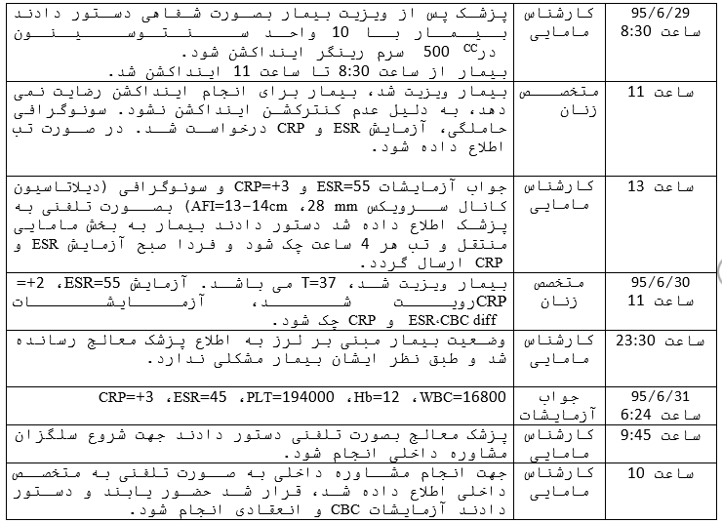
Case report
97/6/1

Slide 9
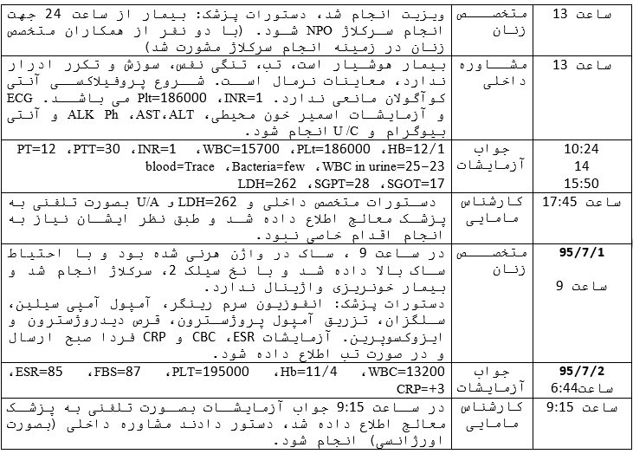
Case report
97/6/1

Slide 10
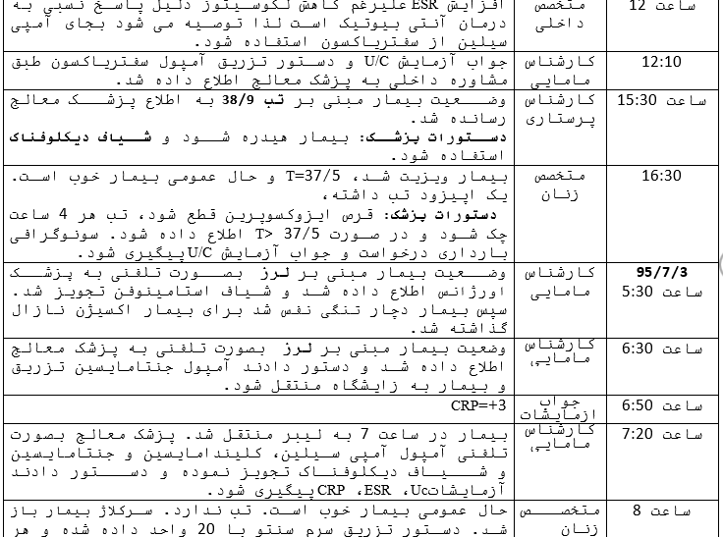
Case report
97/6/1

Slide 11
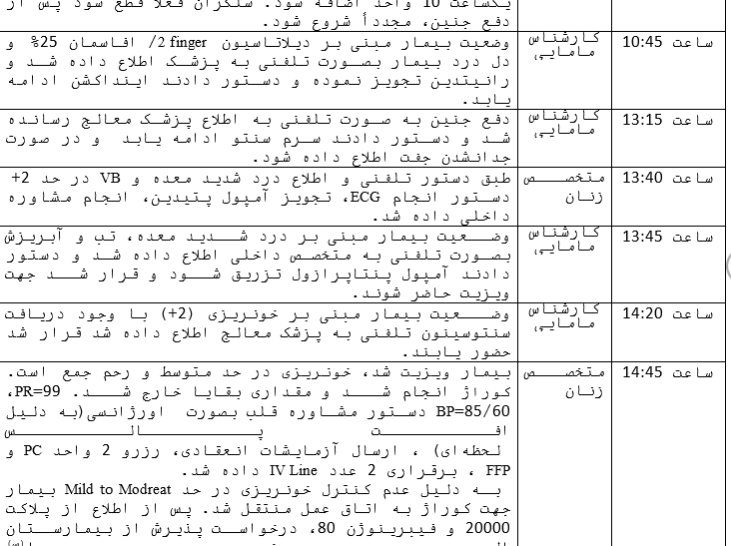
Case report

Slide 12
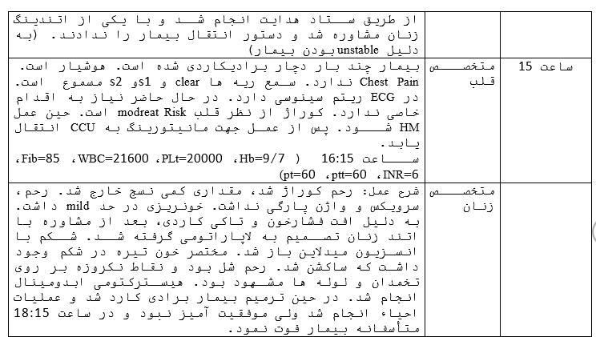
Case report

Slide 13
Case report

Slide 14
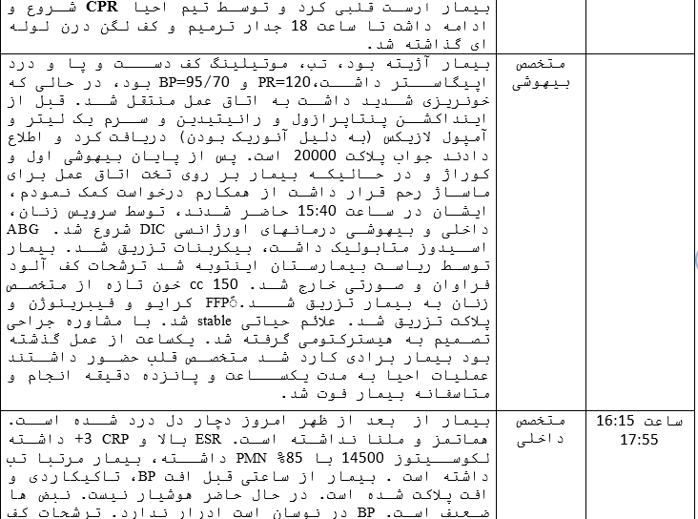
Case report

Slide 15
Case report

Slide 16
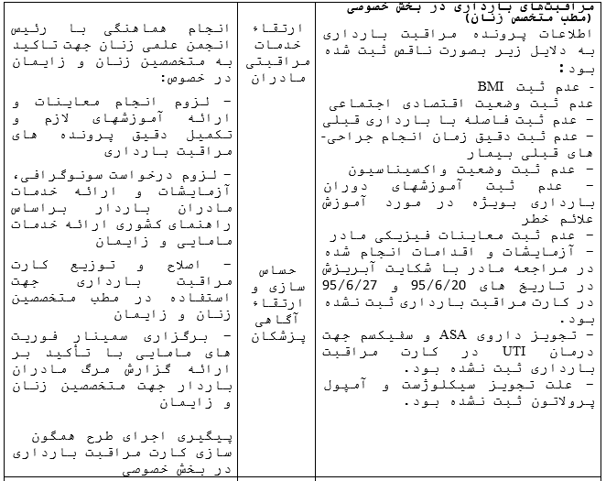
Case report

Slide 17
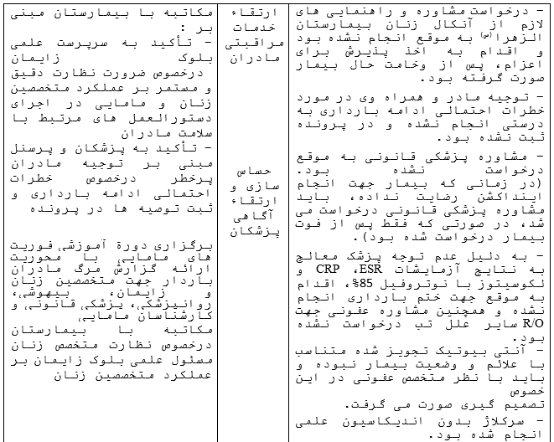
Case report

Slide 18
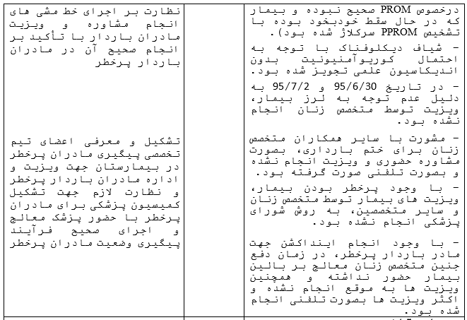
Case report

Slide 19
Case report
Problems
Late diagnosis & management of PROM
Deficient data in patient file
Imperfect documentation
No inform patient & her husband correctly
No direct visit by doctor in time
Cercellage without indication
Late consult with attending
Diclofenac order

Slide 20
DIC
&
SEPTIC SHOCK

Slide 21
WHO statistics
80% of all maternal deaths are:
Severe bleeding (mostly bleeding after childbirth)
infections (usually after childbirth)
pre-eclampsia and eclampsia
unsafe abortion

Slide 22
introduction
Definition of SIRS:
clinical syndrome characterized by systemic response due to infectious or non-infectious causes

Slide 24
introduction
Definition of sepsis:
clinical syndrome characterized by systemic inflammation due to infection

Slide 25
introduction
Definition of severe sepsis:
sepsis associated with tissue
hypoperfusion (eg,↑ lactate, oliguria) or organ dysfunction
(↑creatinine,DIC, ↑BilR,GCS changes,↓plt, ↓Pao2/Fio2 )

Slide 26
introduction
Definition of septic shock:
type of vasodilatory or distributive shock that includes patients who fulfill the criteria for sepsis and
despite adequate fluid resuscitation, require vasopressors to maintain a
mean arterial pressure (MAP) ≥65 mmHg and have a lactate >2 mmol/L (>18 mg/dL).

Slide 27
diagnosis
Symptoms & signs related to an infectious source
T>38.3 or <36
HR>90
SBP<90 ,MAP<70
RR>20
Pao2/Fio2 < 300
Cr rise> 0.5mg/dl
U/O <0.5 cc /kg /hr
WBC>12000 or <4000 or band cell>10%

Slide 28
diagnosis
BS > 140 without DM
INR>1.5 or PTT >60
PLT <100000
Total BilR > 4
↑ K ,↓ Na
Lactat>2mmol/lit
PCT>2 SD above ULN
CRP>2 SD above ULN
Mental status changes
ILeus

Slide 29
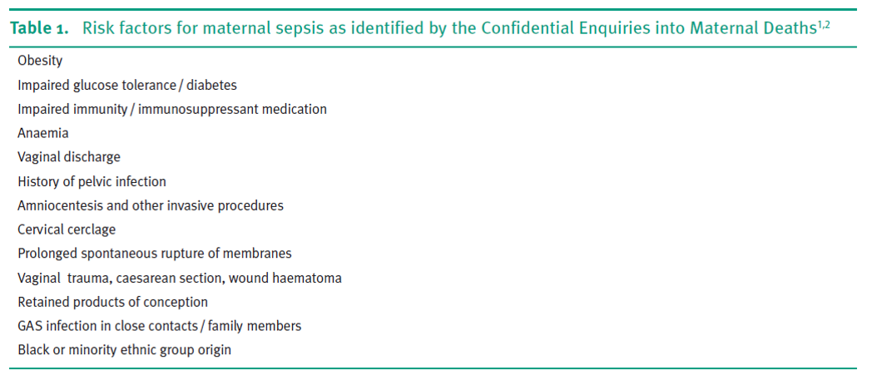
Risk factors

Slide 30
Suspected sourses
Genital tract
Mastitis
urinary tract infection
Respiratory tract
skin and soft-tissue infection
GI tract
Pharyngitis
brain

Slide 31
Management
immediate evaluation & management
HX , VS , GA
Thinking
VE(CMT,malodor discharge,ROM,…)
AE
Review of all systems to find source
LAB Q6 h
Imaging if indicated

Slide 32
Management
Securing air way,correcting hypoxemia
Venus access
Early administration of crystalloid 30cc/kg in first 3h
Early administration of AB(1n first 1-6h)
GC in septic shock resistant to fluid, vasopressors

Slide 33
Management
Duration of IV AB : 7-10d
Total GOAL
Scvo2>70%
U/O > 0.5cc/kg/h
MAP >65
CVP:8-12

Slide 34
THANKS

